Slide 1
Agent-Based Modeling with Symmetric DEVS
Rhys Goldstein
Autodesk Research
Email: rhys.goldstein@autodesk.com
Search for: SyDEVS
Notes:
This tutorial was first presented at the 2019 Spring Simulation Conference in Tucson, Arizona.
Topics covered include DEVS (a way of approaching discrete event simulation), Symmetric DEVS (improving support for agent-based modeling), and SyDEVS (an open source C++ library for developing Symmetric DEVS models).

Slide 2
Why DEVS?
Notes:
Why should we be interested in DEVS?

Slide 3
Why DEVS?
DEVS offers a approach to modeling and simulation
Notes:
A number of words were suggested to fill in the blank, e.g. “systematic”, “theory-based”, “formal”, “modular”, “hierarchical”.

Slide 4
Why DEVS?
DEVS offers a approach to modeling and simulation
scalable
Notes:
DEVS offers a scalable approach to modeling and simulation, meaning that modelers can continue to add, remove, or replace parts of a modeling project without getting overwhelmed by its complexity.

Slide 5
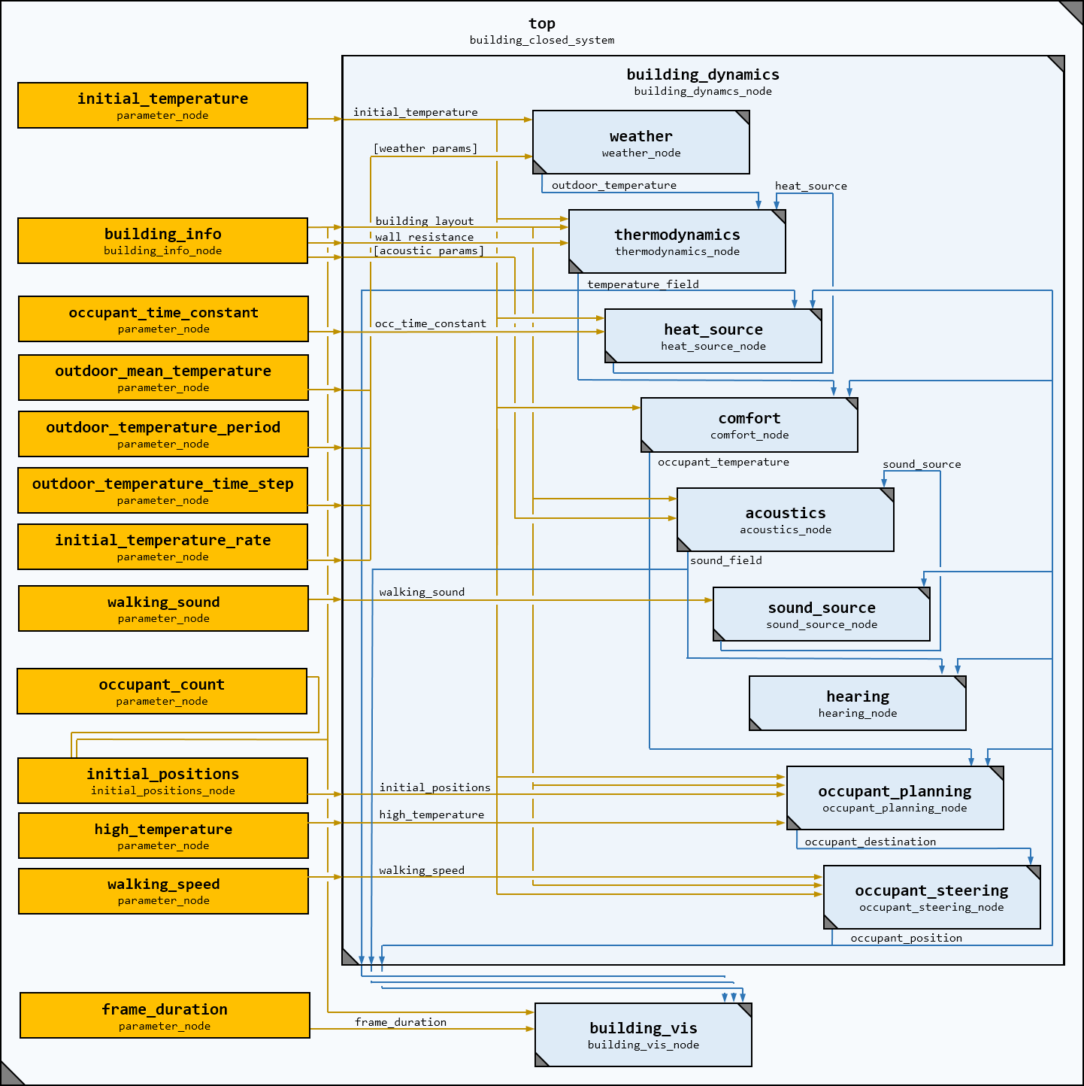
Notes:
Here’s an example of scalability. A building is modeled as a network of simpler models including a thermodynamics model, an acoustics model, and models of other factors that affect how people experience the built environment.

Slide 6
Notes:
Scalability requires not only a modular (e.g. object-oriented) approach to modeling and simulation, but also an approach that minimizes dependencies between modules. In conventional ad-hoc approaches, these dependencies accumulate. Dependencies make it increasingly difficult to cope with the complexity of the project, and may eventually cause development to stagnate.

Slide 7
Nodes
Notes:
With DEVS, the low-level, indivisible atomic models, or atomic nodes, have no explicit dependencies on one another.

Slide 8
Nodes
Notes:
This allows additional nodes to be contributed to a common repository without causing an accumulation of dependencies.

Slide 9
Nodes
Notes:
The idea is to have open source repositories containing numerous nodes, combinations of which can be integrated to form a variety of complex systems models.

Slide 10
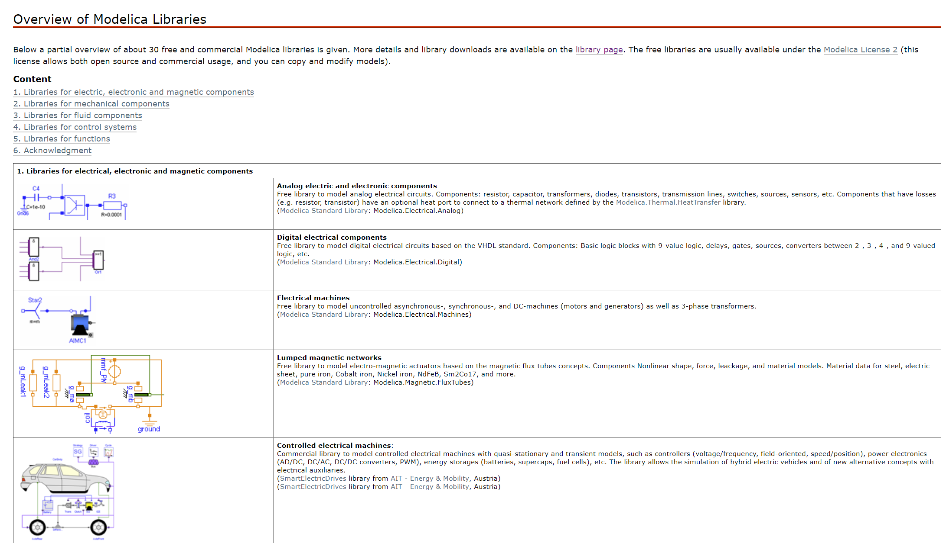

https://www.modelica.org/ModelicaLibrariesOverview
Notes:
This scalable approach is not unique to DEVS. Modelica also involves the use of repositories of independent models that can be linked and simulated using a common simulation engine.

Slide 11
Notes:
Unlike Modelica, which emphasizes the paradigm of equation-based modeling, …

Slide 12
Notes:
…DEVS models like this one are generally implemented with conventional procedural code.

Slide 13

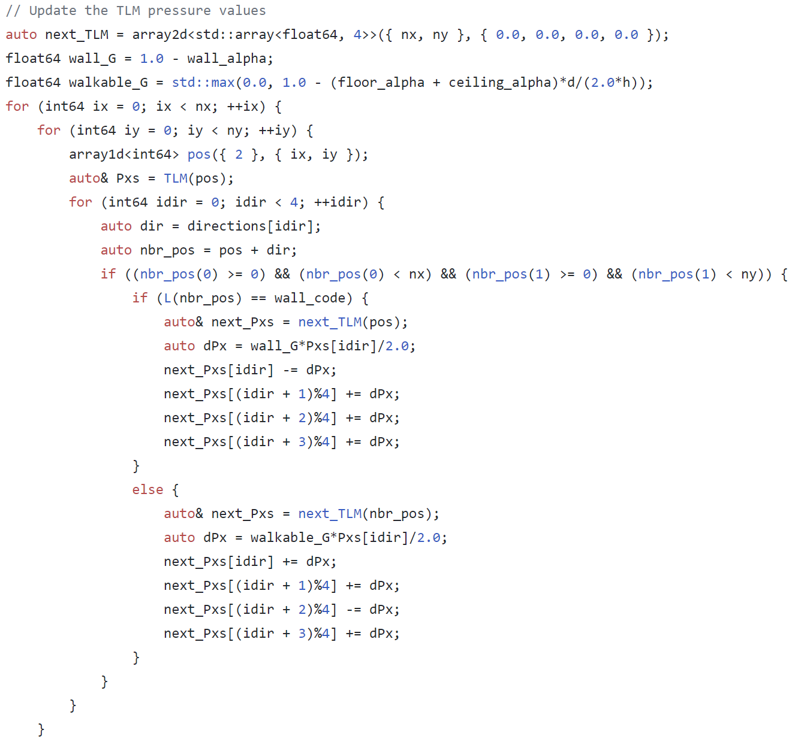
DEVS Code
(procedural)
Notes:
The emphasis on familiar procedural code gives DEVS the potential to appeal to experts in computational subdisciplines of a wide range of fields.

Slide 14
DEVS Variants
Classic DEVS (1976)
Notes:
Classic DEVS was published in 1976.

Slide 15
DEVS Variants
Classic DEVS (1976)
Parallel DEVS (1994)
Notes:
Parallel DEVS was put forward in the ‘90s to handle events in a more concurrent fashion.

Slide 16
DEVS Variants
Generalized DEVS
Routed DEVS
Schedule Preserving DEVS
Cell DEVS
Multi Level DEVS
Symbolic DEVS
Dynamic Structure DEVS
Classic DEVS (1976)
Real Time DEVS
Revised Parallel DEVS
Parallel DEVS (1994)
Stochastic DEVS
Symmetric DEVS
Finite and Deterministic DEVS
Geometric and Kinematic DEVS
Notes:
Many other variants of DEVS were invented because something was deemed missing from either Classic or Parallel DEVS.

Slide 17
DEVS Variants
Symmetric DEVS
Notes:
For Symmetric DEVS, what was deemed missing was…

Slide 18
DEVS Variants
Symmetric DEVS
Approachability
Agent-Based Modeling
Notes:
…approachability and agent-based modeling. We’ll discuss approvability later. For now, we’ll focus on agents.

Slide 19
Agents
Multi-Agent Modeling
Agent-Based Modeling
What’s the difference?
Notes:
Question: What’s the difference between multi-agent modeling and agent-based modeling?

Slide 20
Agents
Multi-Agent Modeling
Agent-Based Modeling (ABM)
Agent behavior is individually modeled.
Agent models are instantiated many times.
Notes:
The difference is that multi-agent modeling pertains to what is being modeled --- specifically systems involving multiple agents --- and agent-based modeling (ABM) pertains to how something is modeled. ABM implies that there is a model of a single agent, and interactions arise from instantiating multiple instances of the agent model and having them interact. The use of an agent model is how a system is modeled in ABM.

Slide 21
DEVS
thermodynamics
thermodynamics_node
controls
controls_node
weather
weather_node
agent
occupant_node
acoustics
acoustics_node
lighting
lighting_node
Notes:
There are a few approaches to handling agents in DEVS.

Slide 22
DEVS + Multi-Agent Modeling
thermodynamics
thermodynamics_node
controls
controls_node
weather
weather_node
agents
occupants_node
acoustics
acoustics_node
lighting
lighting_node
Notes:
The first approach is to use an atomic node representing multiple agents. This is an example of multi-agent modeling but not agent-based modeling, as there is no single-agent model.

Slide 23
DEVS
thermodynamics
thermodynamics_node
controls
controls_node
weather
weather_node
agent
occupant_node
acoustics
acoustics_node
lighting
lighting_node
Notes:
Backing up, …

Slide 24
DEVS + ABM using Dynamic Structure
thermodynamics
thermodynamics_node
controls
controls_node
weather
weather_node
agent
occupant_node
acoustics
acoustics_node
agent
occupant_node
lighting
lighting_node
Notes:
…the second approach is to use a dynamic structure variant of DEVS, which allows agent nodes to be added into an existing structure.

Slide 25
DEVS + ABM using Dynamic Structure
thermodynamics
thermodynamics_node
controls
controls_node
weather
weather_node
agent
occupant_node
acoustics
acoustics_node
agent
occupant_node
lighting
lighting_node
agent
occupant_node
Notes:
The drawback of dynamic structure variants of DEVS is that they can be viewed as complicated.

Slide 26
DEVS
thermodynamics
thermodynamics_node
controls
controls_node
weather
weather_node
agent
occupant_node
acoustics
acoustics_node
lighting
lighting_node
Notes:
Backing up again, …

Slide 27
DEVS + ABM using Collection Nodes
thermodynamics
thermodynamics_node
controls
controls_node
weather
weather_node
agent
occupant_node
agent
occupant_node
agent
occupant_node
agent
occupant_node
agent
occupant_node
agent
occupant_node
agent
occupant_node
agent
occupant_node
agent
occupant_node
agent
occupant_node
agent
occupant_node
agent
occupant_node
acoustics
acoustics_node
lighting
lighting_node
Notes:
…the third approach is to introduce collection nodes, which are like arrays of other nodes of the same type. This is the approach used by Symmetric DEVS.

Slide 28
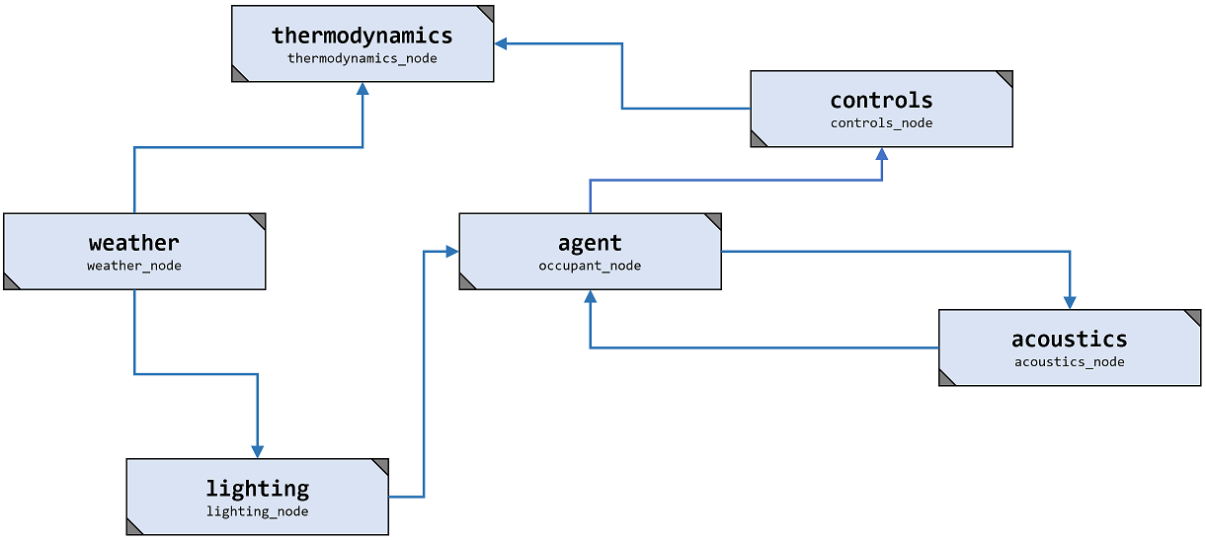
acoustics
acoustics_node
Atomic Model
Coupled Model
Classic DEVS
Notes:
Classic DEVS involves atomic and coupled models.

Slide 29
agent
occupant_node
agent
occupant_node
agent
occupant_node
agent
occupant_node
agent
occupant_node
agent
occupant_node
acoustics
acoustics_node
agent
occupant_node
agent
occupant_node
agent
occupant_node
agent
occupant_node
agent
occupant_node
agent
occupant_node
Atomic Model
Coupled Model
Collection Model
Classic DEVS
Notes:
Adding a third type of model, …

Slide 30
Atomic Node
Composite Node
Collection Node
agent
occupant_node
agent
occupant_node
agent
occupant_node
agent
occupant_node
agent
occupant_node
agent
occupant_node
acoustics
acoustics_node
agent
occupant_node
agent
occupant_node
agent
occupant_node
agent
occupant_node
agent
occupant_node
agent
occupant_node
Atomic Model
Coupled Model
Classic DEVS
Notes:
…and changing the names, …

Slide 31
Symmetric DEVS
Atomic Node
Composite Node
Collection Node
agent
occupant_node
agent
occupant_node
agent
occupant_node
agent
occupant_node
agent
occupant_node
agent
occupant_node
acoustics
acoustics_node
agent
occupant_node
agent
occupant_node
agent
occupant_node
agent
occupant_node
agent
occupant_node
agent
occupant_node
Atomic Model
Coupled Model
Classic DEVS
Notes:
…we see that the atomic, composite, and collection nodes are the three main types of simulation model in Symmetric DEVS.

Slide 32
Tutorial Outline:
DEVS + Agent-Based Modeling
→
The Essence of DEVS
Symmetric DEVS
Agent Behavior
Agent Interaction
The Future of DEVS
Notes:
That concludes the introduction.

Slide 33
Tutorial Outline:
DEVS + Agent-Based Modeling
The Essence of DEVS
→
Symmetric DEVS
Agent Behavior
Agent Interaction
The Future of DEVS
Notes:
Next we’ll take a closer look at DEVS.

Slide 34
Classic DEVS:
〈
〉
,
,
δ_{int}
λ
ta
X
Y
S
δ_{ext}
,
,
,
,
Notes:
DEVS is typically introduced by presenting this tuple and defining each element in order. Here we take a different approach.

Slide 35
Notes:
We’ll introduce DEVS from the ground up.

Slide 36
Simulated Time
Notes:
We start with simulated time. Simulated time is a representation of physical time. Physical time is what most people think of as time --- time in the real world.

Slide 37
State
Simulated Time
Notes:
We now add state, which may consist of many variables of different types. Here state is shown as a one dimensional value for simplicity.

Slide 38
State
Simulated Time
Notes:
Systems are often characterized by continuous change over time.

Slide 39
State
Simulated Time
Notes:
However, many systems are characterized by short periods of rapid change separated by long periods of relative constancy.

Slide 40
State
Simulated Time
Notes:
In some cases, the periods of change are almost imperceptibly brief in comparison with the periods between transitions.

Slide 41
State
Simulated Time
Notes:
These systems are often regarded as discrete, meaning that the state changes at a finite number of points within any finite period of time.

Slide 42
State
Virtual Time
Notes:
Replacing simulated time with virtual time eliminates proportionality with physical time and sets up a basic state machine representation of a system.

Slide 43
Virtual Time
Notes:
Here we eliminate the state axis…

Slide 44
s₀
s₁
s₂
s₃
s₄
s₅
s₆
s₇
Virtual Time
Notes:
…and instead represent state as a succession of values.

Slide 45
x_{A}
x_{B}
x_{C}
x_{D}
x_{E}
x_{F}
x_{G}
s₀
s₁
s₂
s₃
s₄
s₅
s₆
s₇
Virtual Time
Notes:
We assume there are inputs that trigger transitions from one state to another.

Slide 46
x_{A}
x_{B}
x_{C}
x_{D}
x_{E}
x_{F}
x_{G}
s₀
s₁
s₂
s₃
s₄
s₅
s₆
s₇
y_{A}
y_{B}
y_{C}
y_{D}
y_{E}
y_{F}
y_{G}
Virtual Time
Notes:
If we wish, we may also assume there are outputs associated with each transition.

Slide 47
State Machine:
s', y = f (s, x)
x_{A}
x_{B}
x_{C}
x_{D}
x_{E}
x_{F}
x_{G}
s₀
s₁
s₂
s₃
s₄
s₅
s₆
s₇
y_{A}
y_{B}
y_{C}
y_{D}
y_{E}
y_{F}
y_{G}
Virtual Time
Notes:
This leads to a type of state machine where a function f determines how one state s is transformed into another s’, taking in an input x and possibly producing an output y.

Slide 48
State
Simulated Time
Notes:
Backing up, instead of switching to virtual time, it is possible to incorporate simulated time into the transitions of a state machine.

Slide 49
State
Elapsed
Duration
Simulated Time
Notes:
This is done by introducing the elapsed duration, the amount of time elapsed since the previous transition.

Slide 50
State
Total
State
Elapsed
Duration
Simulated Time
Notes:
The state and the elapsed duration together are referred to as the “total state”. In essence, it is now the total state that undergoes transitions.

Slide 51
State
Elapsed
Duration
Simulated Time
Simulated Time
Notes:
With the state being replaced by the total state, there are now two types of transitions.

Slide 52
x
State
Elapsed
Duration
Simulated Time
Notes:
One type of transition is still triggered by inputs.

Slide 53
x
Externally Triggered
State Transition:
State
s', e' = δ_{ext}([s, e], x)
Elapsed
Duration
Simulated Time
Notes:
These externally triggered state transitions are governed by the function δ_{ext}, which…

Slide 54
x
Externally Triggered
State Transition:
State
s', e' = δ_{ext}([s, e], x)
New
Total
State
Elapsed
Duration
Total
State
Simulated Time
Notes:
…takes the current total state and produces the new total state, given the input value x as additional function argument.

Slide 55
x
Externally Triggered
State Transition:
State
s' = δ_{ext}([s, e], x)
Elapsed
Duration
Total
State
Simulated Time
Notes:
The new elapsed duration can be dropped because it is always zero. In essence, however, it is still a transition of the total state.

Slide 56
Internally Triggered
State Transition:
State
[s, e] = [s, e_{limit}]
Elapsed
Duration
Simulated Time
x
Notes:
The other type of transition is triggered by a placing a limit on the total state, which is continuously changing due to the linear increase of the elapsed duration component.

Slide 57
Internally Triggered
State Transition:
State
e = e_{limit}
Elapsed
Duration
Simulated Time
Notes:
Placing a limit on the total state means placing a limit on the elapsed duration, since the state remains constant between transitions.

Slide 58
Internally Triggered
State Transition:
State
e = ta(s)
Elapsed
Duration
Simulated Time
Notes:
The limit is expressed as the result of the time advance function ta applied to the state.

Slide 59
Internally Triggered
State Transition:
State
e = ta(s)
s', e' = δ_{int}([s, e])
Elapsed
Duration
Simulated Time
Notes:
Once the duration ta(s) elapses, internally triggered state transitions are governed by the function δ_{int}.

Slide 60
Internally Triggered
State Transition:
State
e = ta(s)
s', e' = δ_{int}([s, e])
Elapsed
Duration
New
Total
State
Total
State
Simulated Time
Notes:
In essence, δ_{int} represents a transition of the total state.

Slide 61
Internally Triggered
State Transition:
State
e = ta(s)
s' = δ_{int}([s, e])
Elapsed
Duration
Total
State
Simulated Time
Notes:
However the new elapsed duration is omitted because it is always zero, …

Slide 62
Internally Triggered
State Transition:
State
e = ta(s)
s' = δ_{int}(s)
Elapsed
Duration
Simulated Time
Notes:
…and the old elapsed duration is omitted because it can be obtained by applying the known function ta to the known state s.

Slide 63
y
Internally Triggered
State Transition:
State
e = ta(s)
s' = δ_{int}(s)
Elapsed
Duration
Simulated Time
Notes:
Internally triggered state transitions may be associated with an output…

Slide 64
y
Internally Triggered
State Transition:
State
e = ta(s)
y = λ([s, e])
Elapsed
Duration
s' = δ_{int}(s)
Simulated Time
Notes:
…which in essence is produced by applying the output function λ to the total state. The elapsed duration is omitted, however, because it is known to be “ta(s)”.

Slide 65
y
Internally Triggered
State Transition:
State
e = ta(s)
y = λ(s)
Elapsed
Duration
s' = δ_{int}(s)
Simulated Time
Notes:
So there are three functions associated with internally triggered state transitions, …

Slide 66
Externally Triggered
State Transition:
Internally Triggered
State Transition:
s' = δ_{ext}([s, e], x)
e = ta(s)
y = λ(s)
s' = δ_{int}(s)
Notes:
…and one associated with externally triggered state transitions.

Slide 67
Externally Triggered
State Transition:
Internally Triggered
State Transition:
s' = δ_{ext}([s, e], x)
e = ta(s)
y = λ(s)
Total
State
s' = δ_{int}(s)
Notes:
Again, these are in essence transitions of the total state, even though the omission of certain elapsed duration values makes this interpretation a little less obvious.

Slide 68
External Transition:
Internal Transition:
ta
s' = δ_{ext}([s, e], x)
e = ta(s)
δ_{ext}
y = λ(s)
λ
Total
State
δ_{int}
s' = δ_{int}(s)
Notes:
Abbreviating the transition names, …

Slide 69
δ_{ext}
δ_{int}
λ
ta
Notes:
…and adding the…

Slide 70
X
δ_{ext}
δ_{int}
λ
ta
Notes:
…set of possible inputs, …

Slide 71
X
Y
δ_{ext}
δ_{int}
λ
ta
Notes:
…set of possible outputs, …

Slide 72
X
Y
S
δ_{ext}
δ_{int}
λ
ta
Notes:
…and set of possible states…

Slide 73
Classic DEVS:
〈
〉
,
,
δ_{int}
λ
ta
X
Y
S
δ_{ext}
,
,
,
,
Notes:
…we end up with the definition of a DEVS model. As a state machine that incorporates time, DEVS is foundational to modeling and simulation. Unfortunately, it is not as well known as it could be. This is partly because the names and notations are likely to be perceived as unfamiliar and somewhat unapproachable to people outside the systems engineering domain.

Slide 74
X_{P}
ta(s)
Y
S
λ(s)
δ_{ext}
InPorts
Q
OutPorts
X
σ
e
δ_{int}
Y_{P}
ta
λ
Notes:
For example…

Slide 75
X_{P}
ta(s)
Y
S
λ(s)
δ_{ext}
InPorts
Which expressions are time values?
Q
OutPorts
X
σ
e
δ_{int}
Y_{P}
ta
λ
Notes:
…it is not immediately obvious which of these expressions represent time values.

Slide 76
X_{P}
ta(s)
Y
S
λ(s)
δ_{ext}
InPorts
Which expressions are time values?
Q
OutPorts
X
σ
e
δ_{int}
Y_{P}
ta
λ
Notes:
The symbols do not clearly suggest time.

Slide 77
X_{P}
ta(s)
Y
S
λ(s)
δ_{ext}
InPorts
Which expressions are functions?
Q
OutPorts
X
σ
e
δ_{int}
Y_{P}
ta
λ
Notes:
It is not immediately obvious which expressions are functions.

Slide 78
X_{P}
ta(s)
Y
S
λ(s)
δ_{ext}
InPorts
Which expressions are functions?
Q
OutPorts
X
σ
e
δ_{int}
Y_{P}
ta
λ
Notes:
The fact that these symbols are functions is not clearly indicated.

Slide 79
δ_{int}
–
Internal
Transition Function
δ_{ext}
–
External
Transition Function
Notes:
The function that internalizes input information is actually the external transition function, and the function that coincides with outputs to external components is the internal transition function.

Slide 80
δ_{int}
–
Internal
ly Triggered State
Transition Function
δ_{ext}
–
External
ly Triggered State
Transition Function
Notes:
This possible source of confusion can be addressed by un-abbreviating the function names, but then the names become verbose. To make DEVS more approachable, we propose alternative names and notations while retaining the essence of DEVS as a form of state machine that incorporates time.

Slide 81
f_{p}
–
Planned Event Function
f_{u}
–
Unplanned Event Function
Notes:
The internal and external transition functions become the “planned” and “unplanned” event functions, both denoted f with subscripts.

Slide 82
e
–
Elapsed Time
ta(s), σ
–
Time Advance / Lifetime of the State
Notes:
The names of the key time values…

Slide 83
f_{p}
–
Planned Event Function
f_{u}
–
Unplanned Event Function
Δt_{e}
–
Elapsed Duration
Δt_{p}
–
Planned Duration
Notes:
…become the “elapsed duration” and the “planned duration”, both denoted Δt with subscripts.

Slide 84
f_{p}
–
Planned Event Function
f_{u}
–
Unplanned Event Function
Δt_{e}
–
Elapsed Duration
Δt_{p}
–
Planned Duration
[s, ]
e
–
Total State
Notes:
Noted that the “planned duration” is the duration until the next “planned” event, a relationship hinted at by the word “planned” and the subscript p.

Slide 85
f_{p}
–
Planned Event Function
f_{u}
–
Unplanned Event Function
Δt_{e}
Δt_{e}
–
Elapsed Duration
Δt_{p}
–
Planned Duration
[s, ]
e
–
Total State
Notes:
The total state…

Slide 86
f_{p}
–
Planned Event Function
f_{u}
–
Unplanned Event Function
Δt_{e}
–
Elapsed Duration
Δt_{p}
–
Planned Duration
[s, ]
Δt_{e}
–
Total State
e
Notes:
…becomes [s, Δt_{e}].

Slide 87
Model
Notes:
The term “model” is an accurate term, but unfortunately it has a different meaning in many disciplines that could benefit from DEVS. In architectural design, for example, “model” often refers to a digital model of a building.

Slide 88
Class
Node
Instance
Notes:
We propose “node” as an alternative name.

Slide 89
Class
Node
Instance
Notes:
The terms “class” and “instance” might be better than “node”, but they may cause confusion with classes and instances in an object-oriented programming language. The term “node” seems to avoid these potential sources of confusion.

Slide 90
Coupled Model
Notes:
The term “coupled model” is not ideal, because it might be interpreted as a pair of models coupled to one another.

Slide 91
Composite Node
Notes:
We suggest “composite node” instead.

Slide 92
Classic DEVS:
〈
〉
,
,
δ_{int}
λ
ta
X
Y
S
δ_{ext}
,
,
,
,
Notes:
And instead of the Classic DEVS tuple of elements, which exhibits little obvious symmetry, …

Slide 93
Symmetric DEVS:
〈
〉
,
P_{mo}
,
,
f_{init}
,
f_{u}
,
f_{p}
f_{final}
P_{fi}
,
P_{mi}
P_{fo}
,
Notes:
…the proposed Symmetric DEVS variant has a symmetrical structure with 4 port elements and 4 function elements.

Slide 94
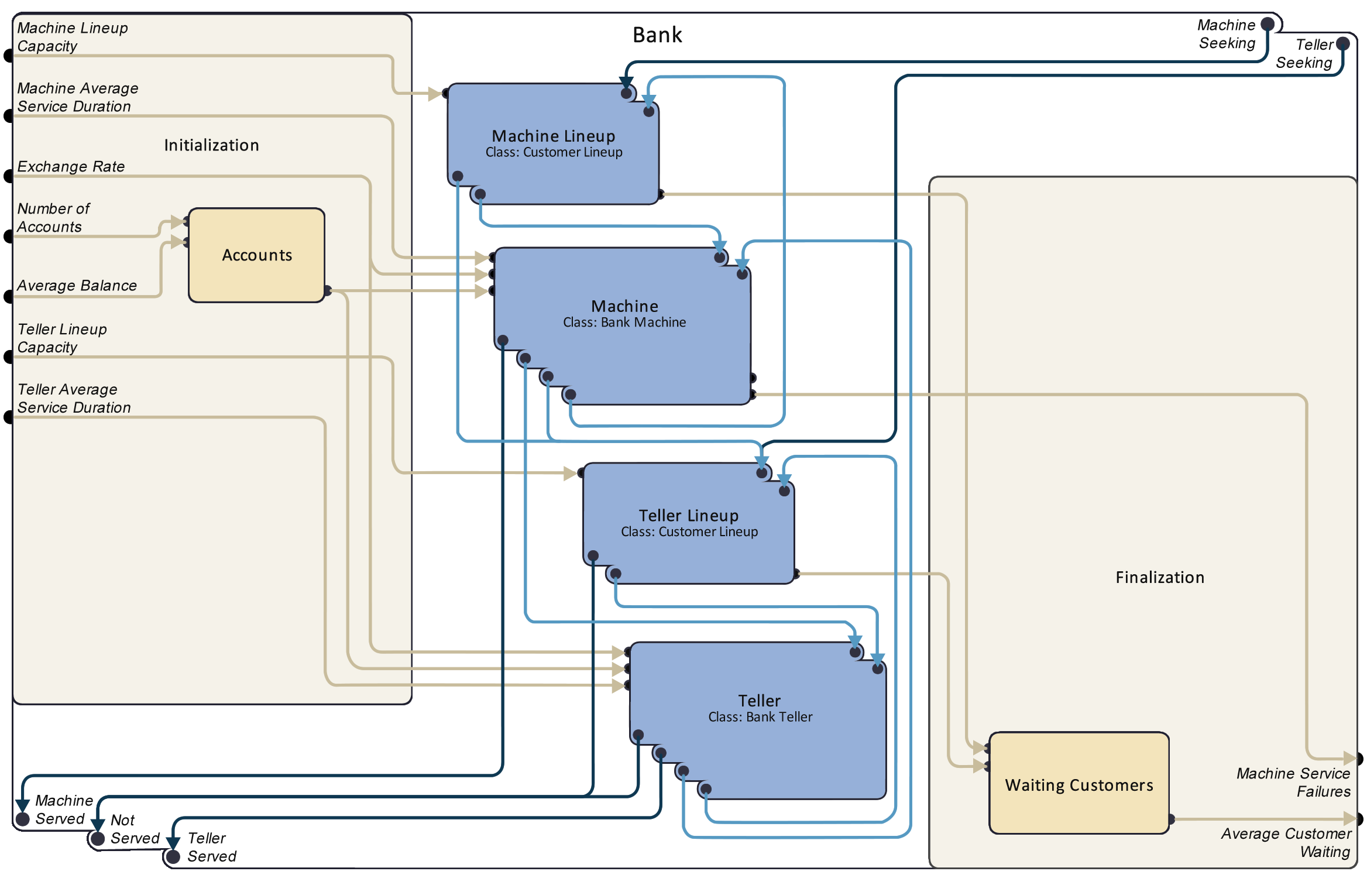
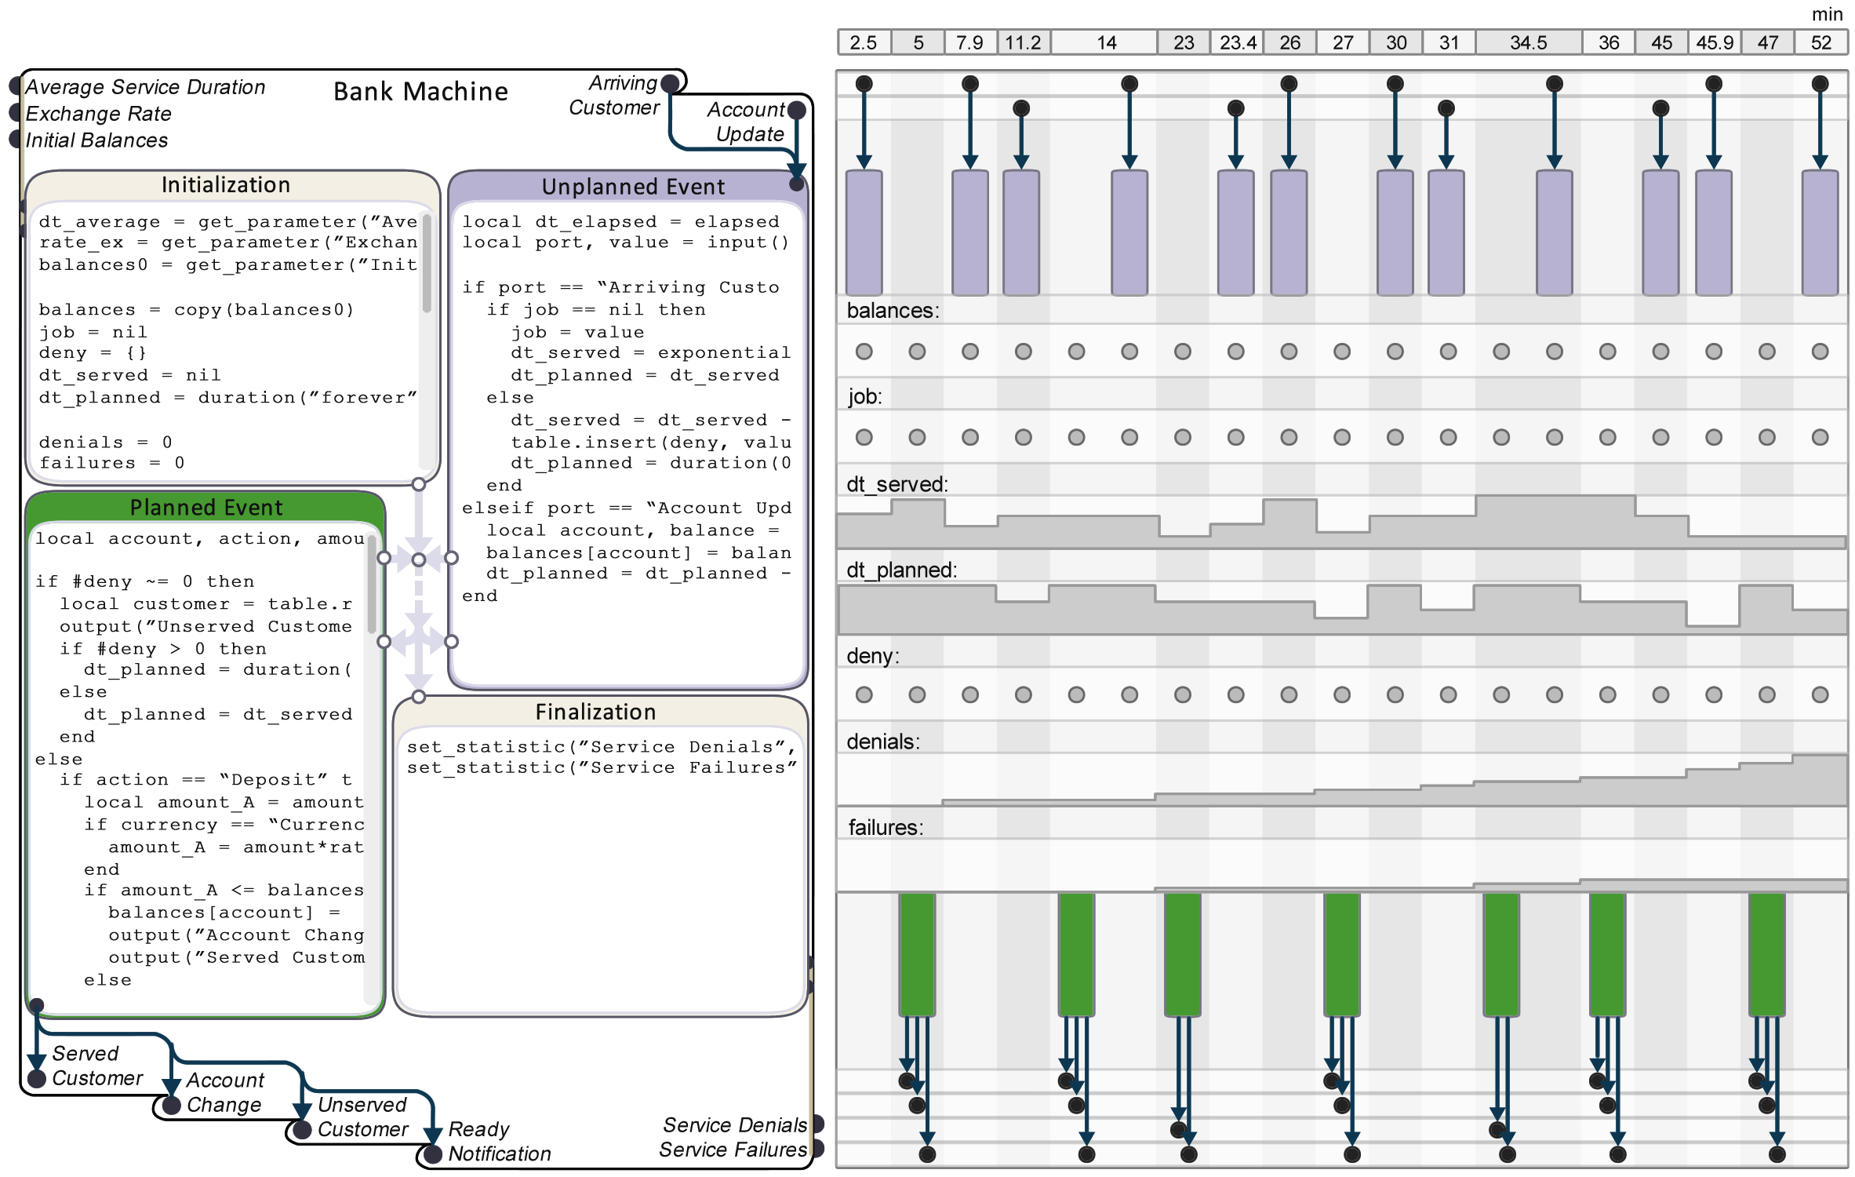
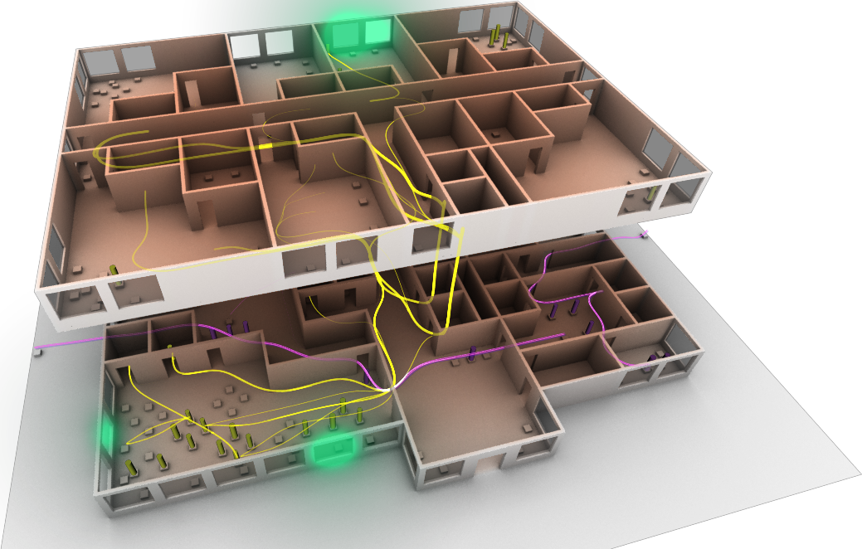
DEVS
Notes:
Although visual interfaces may be a more effective way to attract new users to DEVS, these interfaces will inevitably be influenced by the way the underlying theory is expressed.

Slide 95
Notes:
For example, the interface mockup shown here reflects the 4 types of ports and 4 types of functions in the Symmetric DEVS variant of the Classic DEVS formalism.

Slide 96
Tutorial Outline:
DEVS + Agent-Based Modeling
The Essence of DEVS
→
Symmetric DEVS
Agent Behavior
Agent Interaction
The Future of DEVS
Notes:
To summarize the topic, we consider the essence of DEVS to lie in the interpretation of the formalism as a state machine that incorporates time. This essential feature is retained even if the nomenclature is modified in an attempt to improve approachability.

Slide 97
Tutorial Outline:
DEVS + Agent-Based Modeling
The Essence of DEVS
Symmetric DEVS
→
Agent Behavior
Agent Interaction
The Future of DEVS
Notes:
We now describe in more detail the elements of Symmetric DEVS.

Slide 98
DEVS Variants
Generalized DEVS
Routed DEVS
Schedule Preserving DEVS
Cell DEVS
Multi Level DEVS
Symbolic DEVS
Dynamic Structure DEVS
Classic DEVS (1976)
Real Time DEVS
Revised Parallel DEVS
Parallel DEVS (1994)
Stochastic DEVS
Symmetric DEVS
Finite and Deterministic DEVS
Geometric and Kinematic DEVS
Notes:
Recall there are many variants of Classic and Parallel DEVS, each of which tries to supply something that was deemed missing from the original formalism.

Slide 99
DEVS Variants
Symmetric DEVS
Approachability
Agent-Based Modeling
Notes:
Symmetric DEVS strives to increase approachability and improve support for agent-based modeling. An agent is a system, but not all systems are referred to as agents. If there are many similar systems, and what interests us are the interactions among those systems, then we tend to refer to those systems as “agents”. In ABM, there is a model dedicated to a single agent, and a simulation of interacting agents is realized by instantiating the agent model multiple times.

Slide 100
DEVS
thermodynamics
thermodynamics_node
controls
controls_node
weather
weather_node
agent
occupant_node
acoustics
acoustics_node
lighting
lighting_node
Notes:
Here is a model of a single agent.

Slide 101
DEVS + ABM using Collection Nodes
thermodynamics
thermodynamics_node
controls
controls_node
weather
weather_node
agent
occupant_node
agent
occupant_node
agent
occupant_node
agent
occupant_node
agent
occupant_node
agent
occupant_node
agent
occupant_node
agent
occupant_node
agent
occupant_node
agent
occupant_node
agent
occupant_node
agent
occupant_node
acoustics
acoustics_node
lighting
lighting_node
Notes:
The collection node lets us instantiate the agent model multiple times.

Slide 102
acoustics
acoustics_node
Atomic Model
Coupled Model
Classic DEVS
Notes:
Whereas Classic DEVS involves atomic and coupled models, …

Slide 103
Symmetric DEVS
Atomic Node
Composite Node
Collection Node
agent
occupant_node
agent
occupant_node
agent
occupant_node
agent
occupant_node
agent
occupant_node
agent
occupant_node
acoustics
acoustics_node
agent
occupant_node
agent
occupant_node
agent
occupant_node
agent
occupant_node
agent
occupant_node
agent
occupant_node
Atomic Model
Coupled Model
Classic DEVS
Notes:
…Symmetric DEVS involves atomic, composite, and collection nodes.

Slide 104
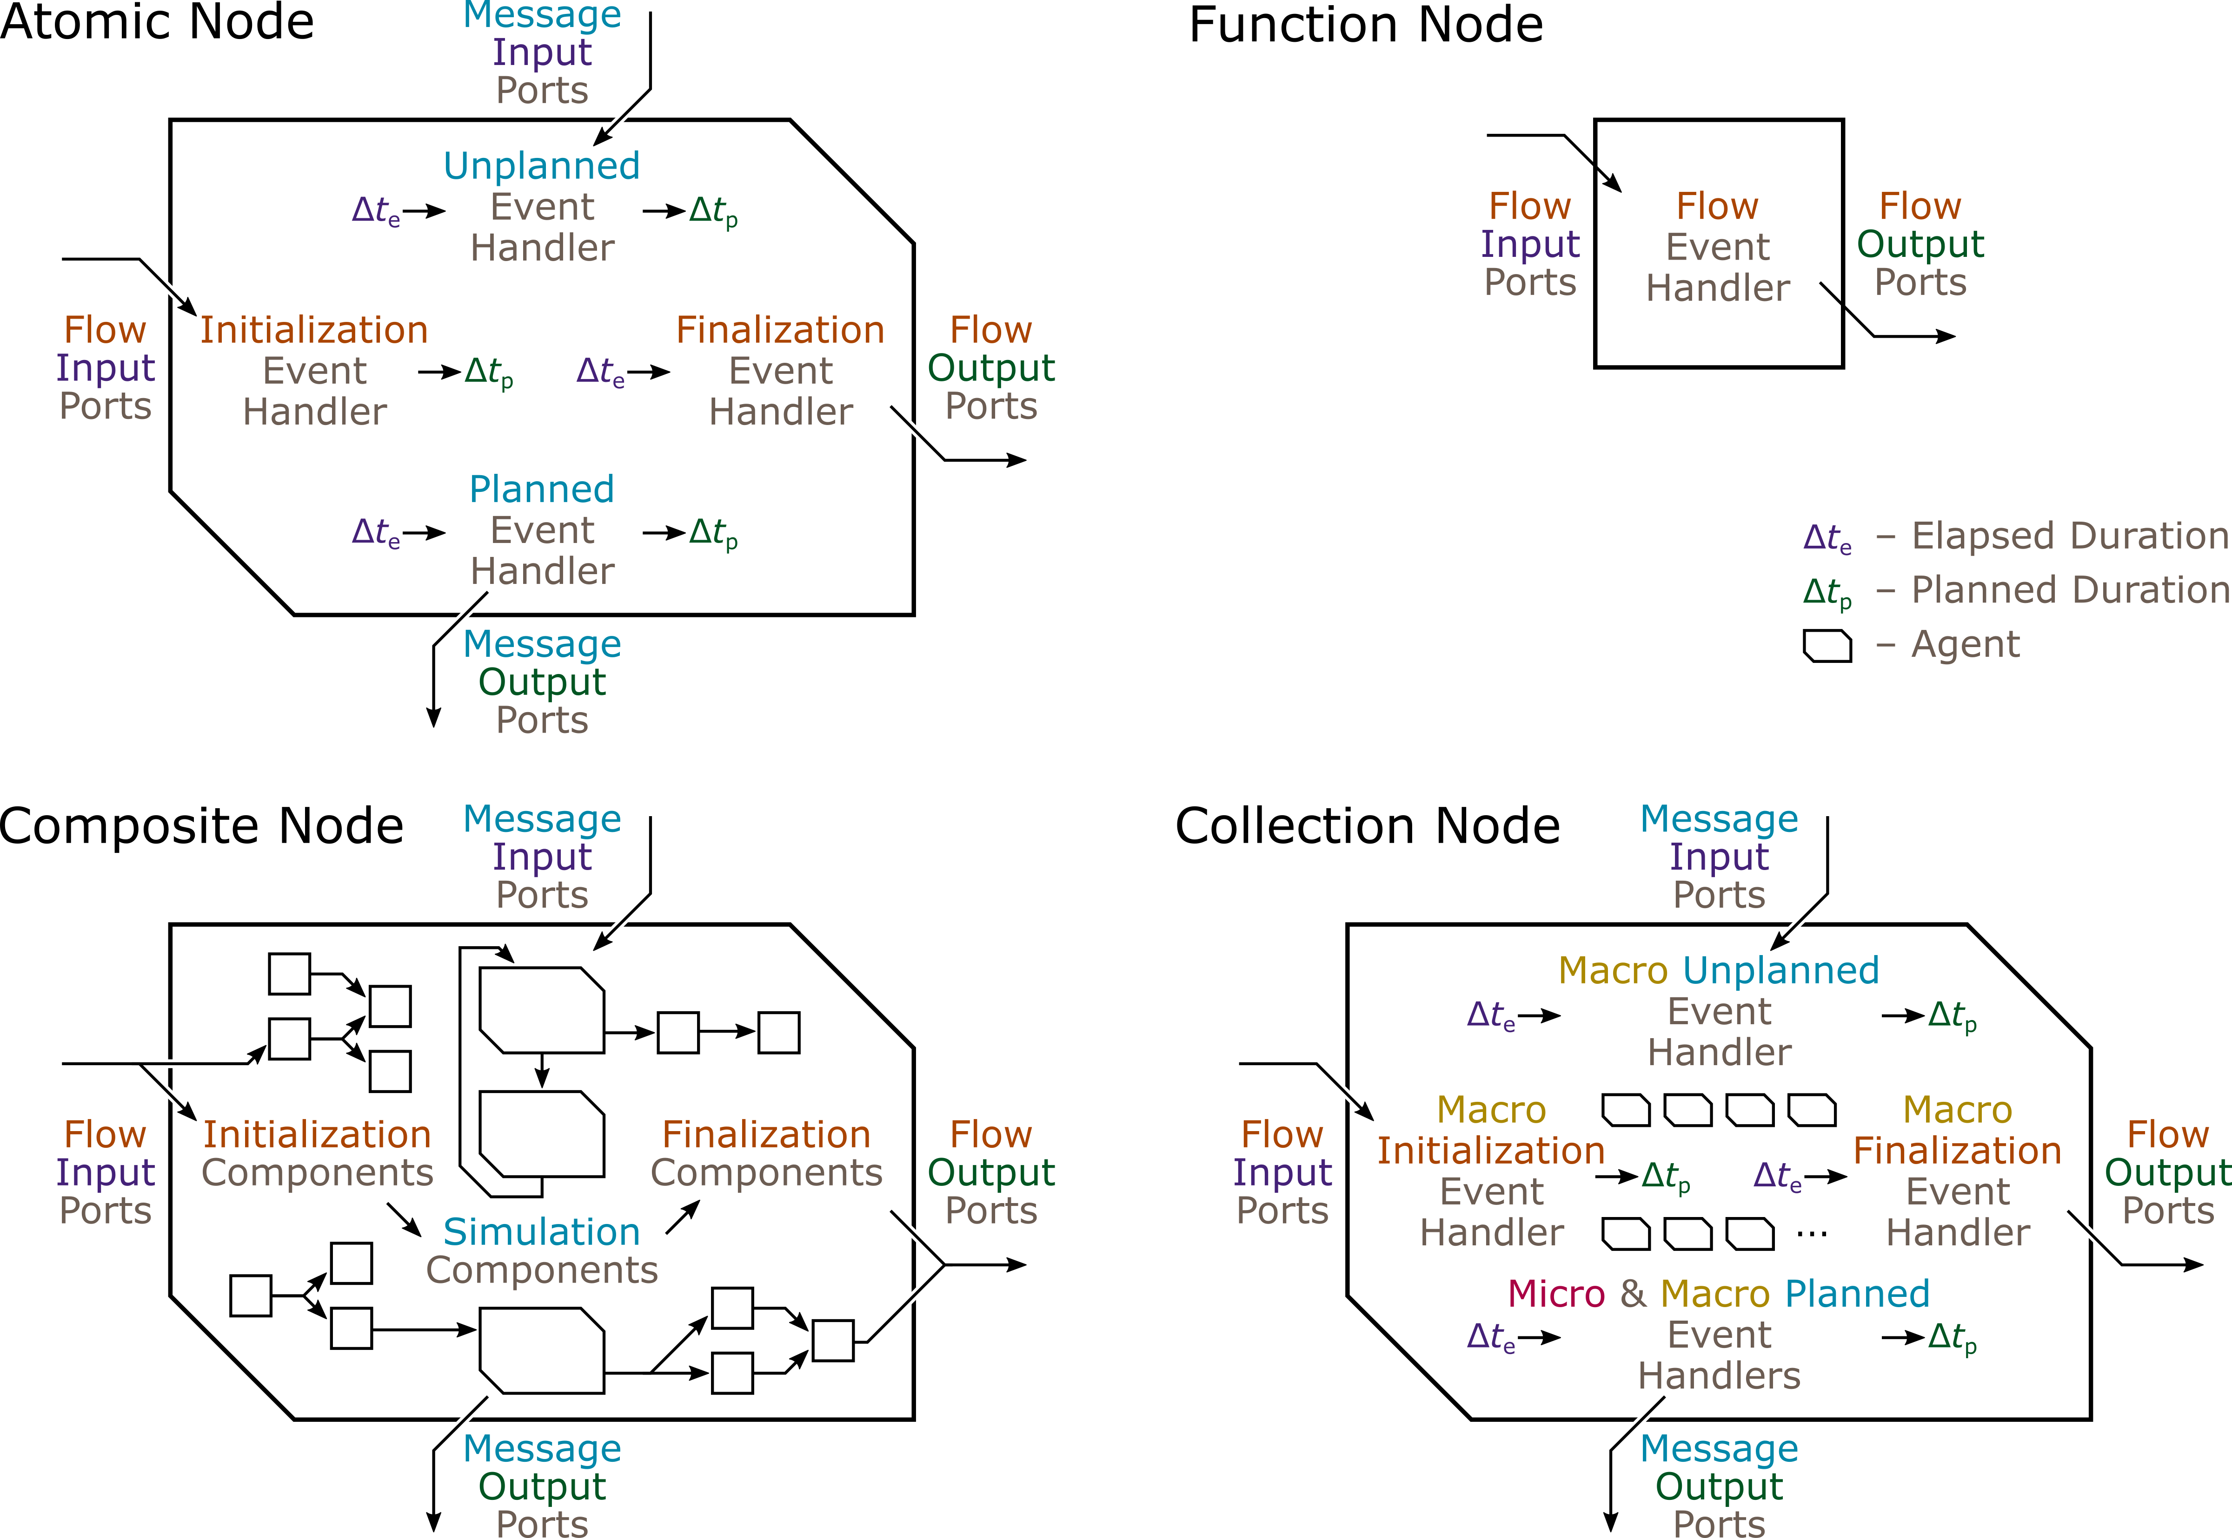
Symmetric DEVS
Notes:
For a detailed explanation of Symmetric DEVS, see Goldstein, Breslav, and Khan (2018): A symmetric formalism for discrete event simulation with agents.
Technically, there are not 3, but rather 4 types of nodes. However, there are 3 types of simulation nodes: atomic, composite, and collection, as previously mentioned. The 4th type of node is the function node, not used for simulation.

Slide 105
Symmetric DEVS
Notes:
A function node takes inputs once, executes a function once, and produces outputs once. It is used to help initialize simulation models or process simulation results.

Slide 106
Symmetric DEVS
Notes:
Next we look at…

Slide 107
Symmetric DEVS
Notes:
…the composite node, a composition of other nodes connected by links.

Slide 108
Composite Node
Notes:
A composite node involves a dataflow programming graph, a directed-acyclic graph of function nodes.

Slide 109
Composite Node
Dataflow
Notes:
Function nodes are executed once, at any time after have the received all flow input values. Once executed, they produce flow output values used by downstream nodes.

Slide 110
Composite Node
Notes:
Unlike a typical dataflow graph, a composite node features a column of simulation nodes. This creates 3 phases of execution.

Slide 111
Composite Node
Initialization (Dataflow)
Notes:
In the initialization phrase, the dataflow graph on the left is processed to supply parameters to the simulation nodes.

Slide 112
Composite Node
Simulation
(DEVS)
Notes:
In the simulation phase, the DEVS nodes send messages to one another, possibly in cycles, as simulated time increases from the beginning to the end of the simulation run.

Slide 113
Composite Node
Finalization (Dataflow)
Notes:
In the finalization phase, a second dataflow graph aggregates the results of the simulation, producing statistics pertaining to the overall network of models. In a typical composite node, however, this finalization dataflow graph is often omitted as usually there are no statistics.

Slide 114
Composite Node
Notes:
The entire dataflow-simulation-dataflow network is embedded in the composite node. Here is an actual example with 9 simulation nodes and a dataflow graph for initialization that contains only links and no function nodes. Note that the initial temperature flow input (parameter) is connected to several simulation nodes. This constrains the nodes to all have the same parameter value. Dataflow programming provides a convenient way to impose this type of constraint.

Slide 115
Composite Node
Notes:
The previously shown composite node is itself a simulation node in an encompassing composite node. The outer node does have function nodes as part of the dataflow graph used for initialization.

Slide 116
Symmetric DEVS
Notes:
That covers the composite node.

Slide 117
Symmetric DEVS
Notes:
Next we look at…

Slide 118
Symmetric DEVS
Notes:
…the atomic node, an indivisible node that uses functions to capture the behavior of a system. The symmetry of these nodes is evident from the image. There are dataflow elements laid out from left to right, and simulation elements laid out from top to bottom. The 4 types of ports are associated with 4 types of functions. All functions take in the elapsed duration since the previous event, except the initialization function since it is the first event. All functions produce the planned duration until the next planned event, except the finalization function since it is the last event.
Although the Symmetric DEVS atomic node is no simpler than the Classic DEVS atomic model, its symmetry may make it appear simpler, and perhaps more complete and easier to remember.

Slide 119
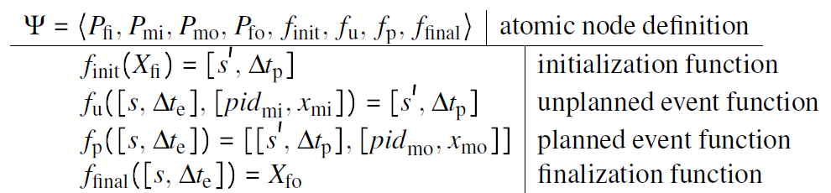
Atomic Node
Notes:
We’ll focus on the mathematical specification of atomic nodes.

Slide 120
Atomic Node
Notes:
Atomic nodes are specified by defining 4 port elements and 4 functions.

Slide 121
Symmetric DEVS:
〈
〉
,
P_{mo}
,
,
f_{init}
,
f_{u}
,
f_{p}
f_{final}
P_{fi}
,
P_{mi}
P_{fo}
,
Notes:
We have seen these elements previously.

Slide 122
Atomic Node
Notes:
Returning to the specification…

Slide 123
Atomic Node
Notes:
…we can see symmetry in the definitions of the unplanned and planned event functions. They both take as input the current state and the elapsed duration, and they both produce the new state an the new planned duration. The unplanned event function also takes a message input port ID and value, and the planned event function may produce a message output consisting of a port ID and value.

Slide 124
Atomic Node
Notes:
The initialization and finalization functions are also symmetrical. The former takes all flow input values and produces the initial state and planned duration. The latter takes the current state and elapsed duration and produces all flow output values.

Slide 125
Symmetric DEVS
Notes:
That covers the atomic node.

Slide 126
Symmetric DEVS
Notes:
Finally, we look at…

Slide 127
Symmetric DEVS
Notes:
…the collection node, essentially an array of other nodes of the same type. It is a multi-level model, meaning there is a macro level associated with the overall collection and a micro level associated with individual agents. At the macro level, the collection node is highly symmetrical featuring the same 4 ports as the other types of simulation node. It also features macro-level versions of the 4 functions of the atomic node. The symmetry is disrupted, however, by a fifth function called the micro planned event function. As previously emphasized, collection nodes support agent-based modeling.

Slide 128
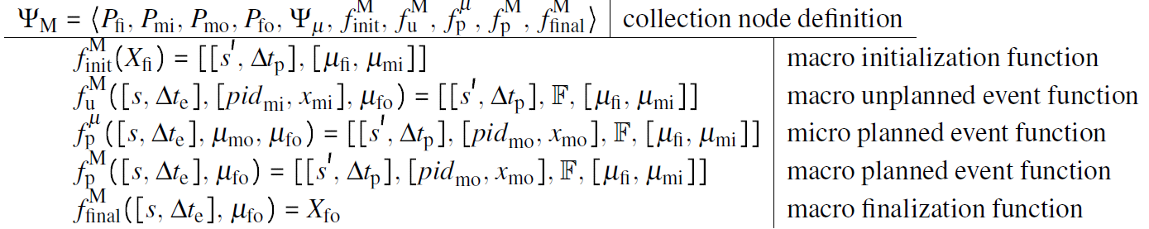
Collection Node
Notes:
Collection node specifications take the form shown here, with 4 port elements, 1 agent definition element, and 5 event handling functions.

Slide 129
Collection Node
Macro-Level Elements
Notes:
The macro-level elements are identical to the elements of the atomic node. However, there are additional elements for…

Slide 130
Collection Node
Terminate Agents
Notes:
…terminating agents, …

Slide 131
Collection Node
Create Agents
Notes:
…creating agents, …

Slide 132
Collection Node
Send Messages to Agents
Notes:
…and sending messages to agents, operations which are always executed in that order.

Slide 133
Collection Node
Receive Message from Agents
Notes:
There is also an element to receive a message from an agent. This triggers the micro planned event function, and it’s the reason why this 5th function exists in collection nodes but not in atomic nodes.

Slide 134
Collection Node
Obtain Agent Statistics
Notes:
Finally, there are elements for collecting statistics from agents, though this capability is rarely used.

Slide 135
Symmetric DEVS
Notes:
That covers the collection node.

Slide 136
Symmetric DEVS
Notes:
The Symmetric DEVS formalism is implemented by the…

Slide 137
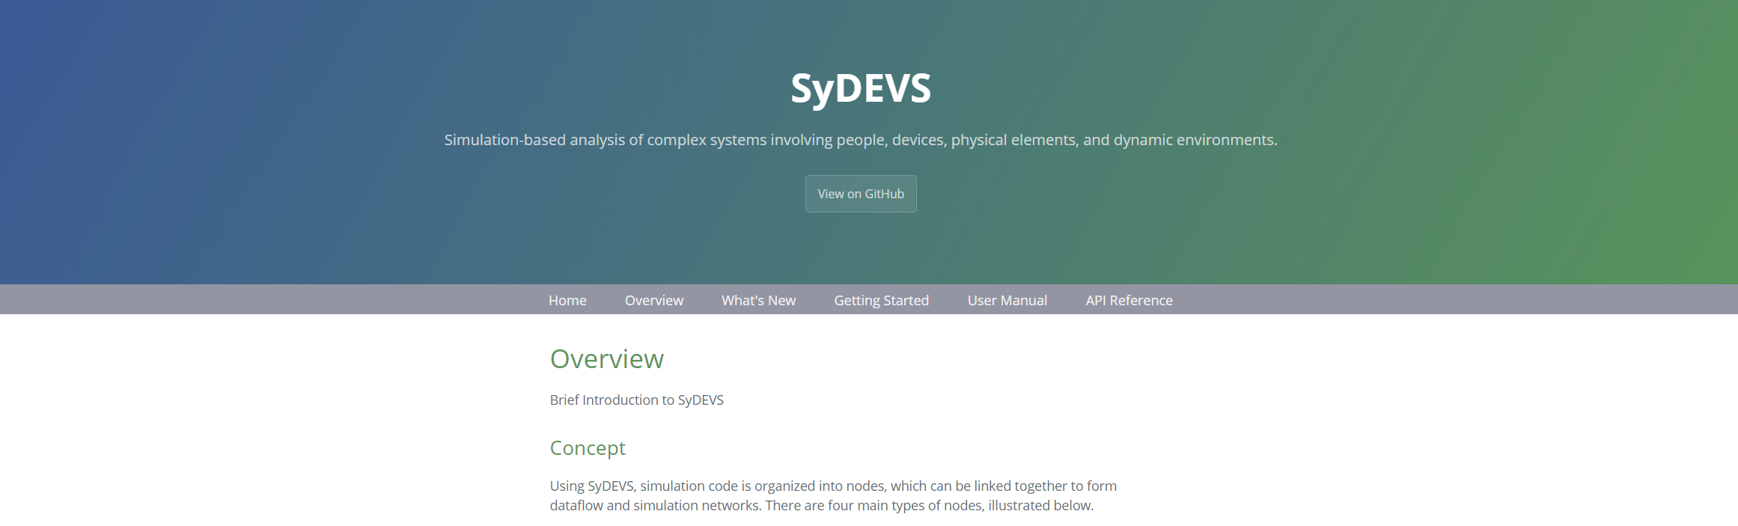
https://autodesk.github.io/sydevs/
Google "SyDEVS"
Notes:
…SyDEVS simulation framework, available as an open source C++ library. For more information, search for “SyDEVS” and visit the website.

Slide 138
Tutorial Outline:
DEVS + Agent-Based Modeling
The Essence of DEVS
Symmetric DEVS
→
Agent Behavior
Agent Interaction
The Future of DEVS
Notes:
Now that all the theory has been covered, it is time to apply it.

Slide 139
Tutorial Outline:
DEVS + Agent-Based Modeling
The Essence of DEVS
Symmetric DEVS
Agent Behavior
→
Agent Interaction
The Future of DEVS
Notes:
We start with an example of an agent.

Slide 140
Ψ_{worker} =
〈
〉
,
P_{mo}
,
,
f_{init}
,
f_{u}
,
f_{p}
f_{final}
P_{fi}
,
P_{mi}
P_{fo}
,
P_{fi}
Notes:
Here is an example of an agent whose behavior is specified by a Symmetric DEVS atomic node. The challenge is to figure out the meaning of the model from the specification. One piece of information can be gained from this first part of the specification: the name of the model --- “worker”.

Slide 141
P_{fi}
P_{fi}("Δt_{work}") = ℝ₀⁺ ∪ {∞} ( work duration )
Flow
Input
Ports
P_{fi}("Δt_{break}") = ℝ⁺ ∪ {∞} ( break duration )
P_{fi}
Message
Input Port
P_{mi}("Δn_{break}") = ℤ ( break population change )
P_{mi}
Message
Output Port
P_{mo}("task") = {"work", "break"} ( new task )
P_{mo}
P_{fo}
f_{init}
f_{u}
f_{p}
f_{final}
Notes:
The model has two parameters (flow input ports), the work duration and the break duration. There is one message input port, which we’ll examine later. There is one message output port, called “task”, which has two possible values: “work” and “break”.

Slide 142
Initialization
Event
f_{init}(X_{fi}) = [[Δt_{work}, Δt_{break}, task, Δt_{p}], Δt_{p}]
Δt_{work} = X_{fi}("work")
Δt_{break} = X_{fi}("break")
task = "work"
Δt_{p} = Δt_{work} ( planned duration )
Notes:
The initialization function assigns four state variables. The first two are just the parameters, which remain constant. There is also the task variable, which is initially “work”, and the planned duration variable, which is initially the work duration. At this point, it may be possible to guess the typical pattern of behavior represented by the model.

Slide 143
f_{u}([[Δt_{work}, Δt_{break}, task, Δt_{p}], Δt_{e}], ["Δn_{break}", Δn_{break}]) = …
[[Δt_{work}, Δt_{break}, task, Δt_{p}' ], Δt_{p}' ]
(task = "work") ⇒ (Δt_{p}' = Δt_{p} - Δt_{e})
(task = "break") ⇒ …
(Δn_{break} = 0) ⇒ (Δt_{p}' = Δt_{p} - Δt_{e})
(Δn_{break} > 0) ⇒ (Δt_{p}' = (Δt_{p}² - Δt_{e}²)^{1/2})
(Δn_{break} < 0) ⇒ (Δt_{p}' = Δt_{p} - (2∙Δt_{p}∙Δt_{e} - Δt_{e}²)^{1/2})
Unplanned
Event
Notes:
We’ll examine the unplanned event function later.

Slide 144
f_{p}([[Δt_{work}, Δt_{break}, task, Δt_{p}], Δt_{e}]) = …
[[Δt_{work}, Δt_{break}, task', Δt_{p}' ], Δt_{p}' ], ["task", task' ]
(task = "work") ⇒ …
task' = "break"
Δt_{p}' = Δt_{break}
(task = "break") ⇒ …
task' = "work"
Δt_{p}' = Δt_{work}
Planned
Event
Notes:
The planned event function should confirm one’s guess about the behavior represented by the model. Essentially, the model represents a worker who alternatives between working and taking a break. When the planned duration elapses, a planned event occurs which switches the task and selects the corresponding duration.

Slide 145
Worker
State
"Work"
"Work"
"Work"
"Break"
"Break"
Simulated Time
Notes:
Here’s an illustration of the worker alternating between working and taking a break.

Slide 146
f_{p}([[Δt_{work}, Δt_{break}, task, Δt_{p}], Δt_{e}]) = …
[[Δt_{work}, Δt_{break}, task', Δt_{p}' ], Δt_{p}' ], ["task", task' ]
(task = "work") ⇒ …
task' = "break"
Δt_{p}' = Δt_{break}
(task = "break") ⇒ …
task' = "work"
Δt_{p}' = Δt_{work}
Planned
Event
Notes:
Backing up, …

Slide 147
f_{u}([[Δt_{work}, Δt_{break}, task, Δt_{p}], Δt_{e}], ["Δn_{break}", Δn_{break}]) = …
[[Δt_{work}, Δt_{break}, task, Δt_{p}' ], Δt_{p}' ]
(task = "work") ⇒ (Δt_{p}' = Δt_{p} - Δt_{e})
(task = "break") ⇒ …
(Δn_{break} = 0) ⇒ (Δt_{p}' = Δt_{p} - Δt_{e})
(Δn_{break} > 0) ⇒ (Δt_{p}' = (Δt_{p}² - Δt_{e}²)^{1/2})
(Δn_{break} < 0) ⇒ (Δt_{p}' = Δt_{p} - (2∙Δt_{p}∙Δt_{e} - Δt_{e}²)^{1/2})
Unplanned
Event
Δt_{p}' = Δt_{p} - Δt_{e}
Δt_{p}' = Δt_{p} - Δt_{e}
Δt_{p}' = (Δt_{p}² - Δt_{e}²)^{1/2}
Δt_{p}' = Δt_{p} - (2∙Δt_{p}∙Δt_{e} - Δt_{e}²)^{1/2}
Notes:
…we examine the unplanned event function, which is triggered by inputs representing a change Δn_{break} in the number of workers taking a break. Depending on this input and the current task, the planned duration Δt_{p}' is updated according to one of three formulas.

Slide 148
Δt_{p}' = Δt_{p} - (2∙Δt_{p}∙Δt_{e} - Δt_{e}²)^{1/2}
Δt_{p}' = (Δt_{p}² - Δt_{e}²)^{1/2}
Δt_{p}' = Δt_{p} - Δt_{e}
Δt_{p}' = Δt_{p} - Δt_{e}
Δt_{e}
Δt_{p}
Δt_{e}
Δt_{p}
Δt_{e}
Δt_{p}
Notes:
If we plot the formulas as functions of the elapsed duration, we find that one of them effectively reschedules the planned event for the same time (Δt_{p} - Δt_{e}, meaning the new planned duration is the same as the old one, minus the duration of time that has already elapsed); one of them delays the planned event ((Δt_{p}² - Δt_{e}²)^{1/2}); and one of them makes the planned event more imminent (Δt_{p} - (2∙Δt_{p}∙Δt_{e} - Δt_{e}²)^{1/2}).

Slide 149
f_{u}([[Δt_{work}, Δt_{break}, task, Δt_{p}], Δt_{e}], ["Δn_{break}", Δn_{break}]) = …
[[Δt_{work}, Δt_{break}, task, Δt_{p}' ], Δt_{p}' ]
(task = "work") ⇒ (Δt_{p}' = Δt_{p} - Δt_{e})
(task = "break") ⇒ …
(Δn_{break} = 0) ⇒ (Δt_{p}' = Δt_{p} - Δt_{e})
(Δn_{break} > 0) ⇒ (Δt_{p}' = (Δt_{p}² - Δt_{e}²)^{1/2})
(Δn_{break} < 0) ⇒ (Δt_{p}' = Δt_{p} - (2∙Δt_{p}∙Δt_{e} - Δt_{e}²)^{1/2})
Unplanned
Event
Δt_{p}' = Δt_{p} - Δt_{e}
Δt_{p}' = Δt_{p} - Δt_{e}
Δt_{p}' = (Δt_{p}² - Δt_{e}²)^{1/2}
Δt_{p}' = Δt_{p} - (2∙Δt_{p}∙Δt_{e} - Δt_{e}²)^{1/2}
Notes:
If the worker is working, the planned event is rescheduled for the same time. If the worker is taking a break and there is no change in the number of other workers taking a break, the planned event is rescheduled for the same time. If the worker is taking a break and a co-worker begins their break, then the first worker extends their break by delaying the planned event. If the worker is taking a break and a co-worker ends their break, then the first worker shortens their break by hastening the occurrence of the next planned event.
The basic idea is that a worker will extend their break to socialize if another worker arrives on break, and shorten their break if another worker leaves.

Slide 150
Initialization
Event
f_{init}(X_{fi}) = [[Δt_{work}, Δt_{break}, task, Δt_{p}], Δt_{p}]
Δt_{work} = X_{fi}("work")
Δt_{break} = X_{fi}("break")
task = "work"
Δt_{p} = Δt_{work} ( planned duration )
Notes:
Heading upward to the top of the specification, …

Slide 151
P_{fi}
P_{fi}("Δt_{work}") = ℝ₀⁺ ∪ {∞} ( work duration )
Flow
Input
Ports
P_{fi}("Δt_{break}") = ℝ⁺ ∪ {∞} ( break duration )
P_{fi}
Message
Input Port
P_{mi}("Δn_{break}") = ℤ ( break population change )
P_{mi}
Message
Output Port
P_{mo}("task") = {"work", "break"} ( new task )
P_{mo}
P_{fo}
f_{init}
f_{u}
f_{p}
f_{final}
Notes:
…here are the port definitions, …

Slide 152
class worker_node : public atomic_node
{
public:
// Constructor/Destructor:
worker_node(const std::string& node_name, const node_context& external_context);
virtual ~worker_node() = default;
// Attributes:
virtual scale time_precision() const { return micro; }
// Ports:
port<flow, input, duration> work_dt_input; // work duration
port<flow, input, duration> break_dt_input; // break duration
port<message, input, int64> break_dn_input; // change in the number of workers on break
port<message, output, std::string> task_output; // new task (either "work" or "break")
protected:
// State Variables:
duration work_dt; // work duration (constant)
duration break_dt; // break duration (constant)
std::string task; // current task
duration planned_dt; // planned duration
// Event Handlers:
virtual duration initialization_event();
virtual duration unplanned_event(duration elapsed_dt);
virtual duration planned_event(duration elapsed_dt);
virtual void finalization_event(duration elapsed_dt);
};
P_{fi}
P_{fi}
P_{mi}
P_{mo}
Notes:
…and here is the C++ code that declares the node and its ports in SyDEVS.

Slide 153
P_{fi}
P_{fi}("Δt_{work}") = ℝ₀⁺ ∪ {∞} ( work duration )
Flow
Input
Ports
P_{fi}("Δt_{break}") = ℝ⁺ ∪ {∞} ( break duration )
P_{fi}
Message
Input Port
P_{mi}("Δn_{break}") = ℤ ( break population change )
P_{mi}
Message
Output Port
P_{mo}("task") = {"work", "break"} ( new task )
P_{mo}
Notes:
Returning to the specification, …

Slide 154
Initialization
Event
f_{init}(X_{fi}) = [[Δt_{work}, Δt_{break}, task, Δt_{p}], Δt_{p}]
Δt_{work} = X_{fi}("work")
Δt_{break} = X_{fi}("break")
task = "work"
Δt_{p} = Δt_{work} ( planned duration )
Δt_{work}
Δt_{break}
task
Δt_{p}
Notes:
…here is the initialization function, …

Slide 155
duration worker_node::initialization_event()
{
work_dt = work_dt_input.value().fixed_at(time_precision());
break_dt = break_dt_input.value().fixed_at(time_precision());
task = "work";
planned_dt = work_dt;
return planned_dt;
}
Δt_{work}
Δt_{break}
task
Δt_{p}
Notes:
…and here is the implementation.

Slide 156
Initialization
Event
f_{init}(X_{fi}) = [[Δt_{work}, Δt_{break}, task, Δt_{p}], Δt_{p}]
Δt_{work} = X_{fi}("work")
Δt_{break} = X_{fi}("break")
task = "work"
Δt_{p} = Δt_{work} ( planned duration )
Δt_{work}
Δt_{break}
task
Δt_{p}
Notes:
Returning to the specification, …

Slide 157
f_{u}([[Δt_{work}, Δt_{break}, task, Δt_{p}], Δt_{e}], ["Δn_{break}", Δn_{break}]) = …
[[Δt_{work}, Δt_{break}, task, Δt_{p}' ], Δt_{p}' ]
(task = "work") ⇒ (Δt_{p}' = Δt_{p} - Δt_{e})
(task = "break") ⇒ …
(Δn_{break} = 0) ⇒ (Δt_{p}' = Δt_{p} - Δt_{e})
(Δn_{break} > 0) ⇒ (Δt_{p}' = (Δt_{p}² - Δt_{e}²)^{1/2})
(Δn_{break} < 0) ⇒ (Δt_{p}' = Δt_{p} - (2∙Δt_{p}∙Δt_{e} - Δt_{e}²)^{1/2})
Unplanned
Event
Δt_{p}' = Δt_{p} - Δt_{e}
Δt_{p}' = Δt_{p} - Δt_{e}
Δt_{p}' = (Δt_{p}² - Δt_{e}²)^{1/2}
Δt_{p}' = Δt_{p} - (2∙Δt_{p}∙Δt_{e} - Δt_{e}²)^{1/2}
Notes:
…here is the unplanned event function, …

Slide 158
duration worker_node::unplanned_event(duration elapsed_dt)
{
if (break_dn_input.received()) {
int64 break_dn = break_dn_input.value();
if (task == "work") {
planned_dt -= elapsed_dt;
}
else if (task == "break") {
if (break_dn == 0) {
planned_dt -= elapsed_dt;
}
else {
auto pdt = double(planned_dt/duration(1, time_precision()));
auto edt = double(elapsed_dt/duration(1, time_precision()));
if (break_dn > 0) {
planned_dt = duration(int64(sqrt(pdt*pdt - edt*edt)), time_precision());
}
else if (break_dn < 0) {
planned_dt = duration(int64(pdt - sqrt(2*pdt*edt - edt*edt)), time_precision());
}
}
}
}
return planned_dt;
}
Δt_{p}' = Δt_{p} - Δt_{e}
Δt_{p}' = Δt_{p} - Δt_{e}
Δt_{p}' = (Δt_{p}² - Δt_{e}²)^{1/2}
Δt_{p}' = Δt_{p} - (2∙Δt_{p}∙Δt_{e} - Δt_{e}²)^{1/2}
Notes:
…and here’s the implementation.

Slide 159
f_{u}([[Δt_{work}, Δt_{break}, task, Δt_{p}], Δt_{e}], ["Δn_{break}", Δn_{break}]) = …
[[Δt_{work}, Δt_{break}, task, Δt_{p}' ], Δt_{p}' ]
(task = "work") ⇒ (Δt_{p}' = Δt_{p} - Δt_{e})
(task = "break") ⇒ …
(Δn_{break} = 0) ⇒ (Δt_{p}' = Δt_{p} - Δt_{e})
(Δn_{break} > 0) ⇒ (Δt_{p}' = (Δt_{p}² - Δt_{e}²)^{1/2})
(Δn_{break} < 0) ⇒ (Δt_{p}' = Δt_{p} - (2∙Δt_{p}∙Δt_{e} - Δt_{e}²)^{1/2})
Unplanned
Event
Δt_{p}' = Δt_{p} - Δt_{e}
Δt_{p}' = Δt_{p} - Δt_{e}
Δt_{p}' = (Δt_{p}² - Δt_{e}²)^{1/2}
Δt_{p}' = Δt_{p} - (2∙Δt_{p}∙Δt_{e} - Δt_{e}²)^{1/2}
Notes:
Returning to the specification, …

Slide 160
f_{p}([[Δt_{work}, Δt_{break}, task, Δt_{p}], Δt_{e}]) = …
[[Δt_{work}, Δt_{break}, task', Δt_{p}' ], Δt_{p}' ], ["task", task' ]
(task = "work") ⇒ …
task' = "break"
Δt_{p}' = Δt_{break}
(task = "break") ⇒ …
task' = "work"
Δt_{p}' = Δt_{work}
(task = "work") ⇒ …
task' = "break"
Δt_{p}' = Δt_{break}
(task = "break") ⇒ …
task' = "work"
Δt_{p}' = Δt_{work}
Planned
Event
Notes:
here’s the planned event function, …

Slide 161
duration worker_node::planned_event(duration elapsed_dt)
{
if (task == "work") {
task = "break";
planned_dt = break_dt;
}
else if (task == "break") {
task = "work";
planned_dt = work_dt;
}
task_output.send(task);
return planned_dt;
}
(task = "work") ⇒ …
task' = "break"
Δt_{p}' = Δt_{break}
(task = "break") ⇒ …
task' = "work"
Δt_{p}' = Δt_{work}
Notes:
…and here’s the implementation. Notice the send instruction that outputs the task.

Slide 162
f_{p}([[Δt_{work}, Δt_{break}, task, Δt_{p}], Δt_{e}]) = …
[[Δt_{work}, Δt_{break}, task', Δt_{p}' ], Δt_{p}' ], ["task", task' ]
(task = "work") ⇒ …
task' = "break"
Δt_{p}' = Δt_{break}
(task = "break") ⇒ …
task' = "work"
Δt_{p}' = Δt_{work}
(task = "work") ⇒ …
task' = "break"
Δt_{p}' = Δt_{break}
(task = "break") ⇒ …
task' = "work"
Δt_{p}' = Δt_{work}
Planned
Event
Notes:
Returning to the specification, the send instruction corresponds to the task message output port and value at the top right.

Slide 163
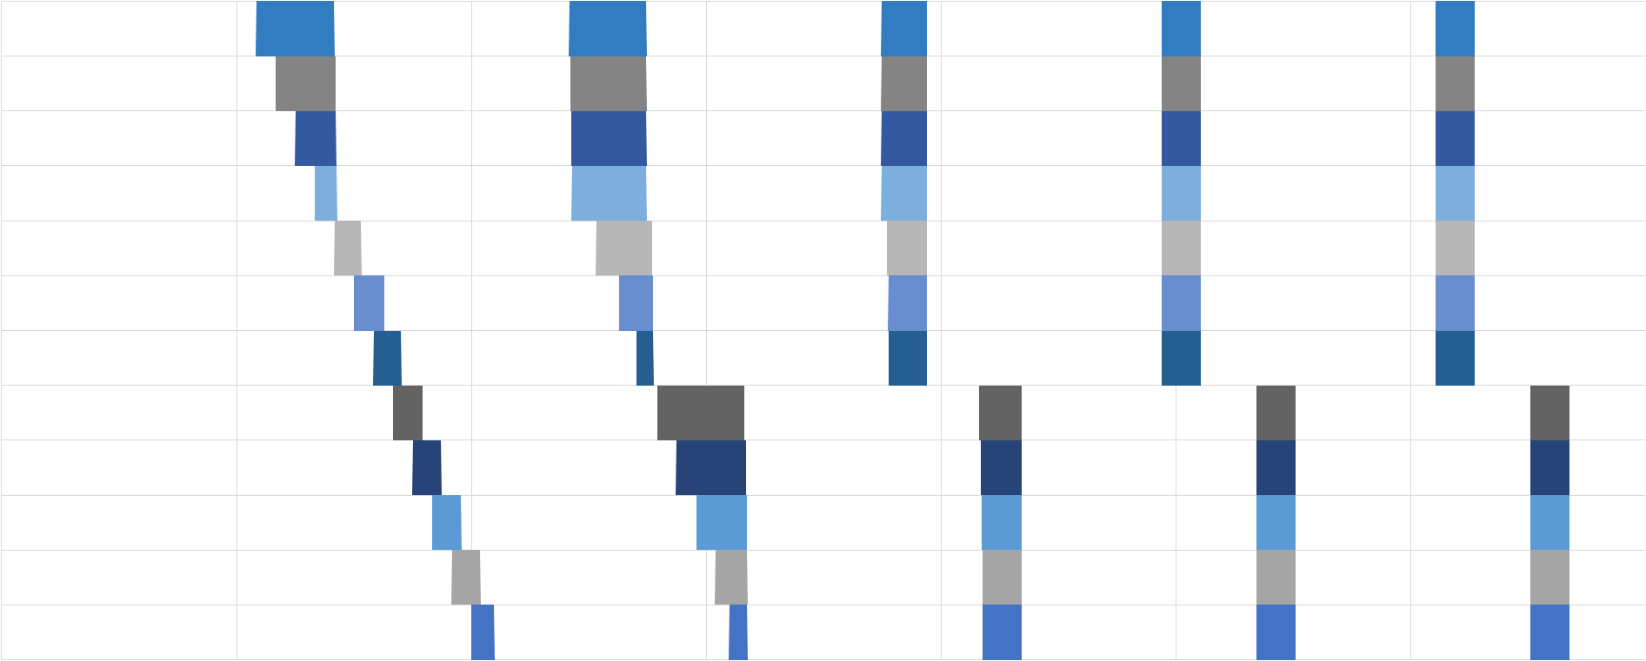
Results
Agent 0
Agent 1
Agent 2
Agent 3
Agent 4
Agent 5
Agent 6
Agent 7
Agent 8
Agent 9
Agent 10
Agent 11
1 2 3 4 5 6
Hours
Notes:
This timeline was produced by 12 interacting instances of the worker example model. The workers enter the system at 5-minute intervals starting in the "work" state. The colored bars indicate when each worker is taking a break. Although the breaks are initially staggered, a challenge is to anticipate the type of behavior that will emerge over the next several hours, which have been concealed.

Slide 164
Results
Agent 0
Agent 1
Agent 2
Agent 3
Agent 4
Agent 5
Agent 6
Agent 7
Agent 8
Agent 9
Agent 10
Agent 11
1 2 3 4 5 6
Hours
Notes:
The behavior that emerges is that break start and end times begin to synchronize. In this case, two distinct groups of workers form, each with its own common break schedule.

Slide 165
Tutorial Outline:
DEVS + Agent-Based Modeling
The Essence of DEVS
Symmetric DEVS
Agent Behavior
→
Agent Interaction
The Future of DEVS
Notes:
Now that an atomic node for an individual worker agent has been defined, …

Slide 166
Tutorial Outline:
DEVS + Agent-Based Modeling
The Essence of DEVS
Symmetric DEVS
Agent Behavior
→
Agent Interaction
The Future of DEVS
Notes:
…we’ll define a collection node that supports interaction among these agents.

Slide 167
〈
〉
,
P_{mo}
,
,
f_{init}
,
f_{u}
,
f_{p}
f_{final}
P_{fi}
,
P_{mi}
P_{fo}
,
Ψ_{worker} =
P_{fi}
Agent 0
Agent 1
Agent 2
Agent 3
Agent 4
Agent 5
Agent 6
Agent 7
Agent 8
Agent 9
Agent 10
Agent 11
Notes:
Here is the worker definition and simulation results, as seen previously.

Slide 168
Ψ_{workplace} =
〈
〉
,
P_{mo}
,
,
f_{init}
,
f_{u}
,
f_{p}
f_{final}
,
P_{mi}
P_{fo}
,
f_{p}
,
,
P_{fi}
Ψ_{μ}
P_{fi}
^{M}
^{M}
^{μ}
^{M}
^{M}
Notes:
This is the specification of the collection node “workplace”, which creates and coordinates multiple worker agents.

Slide 169
P_{fi}
P_{fi}("Δt_{work}") = ℝ₀⁺ ∪ {∞} ( work duration )
P_{fi}("Δt_{break}") = ℝ⁺ ∪ {∞} ( break duration )
P_{fi}
P_{mi}("arrival") = {aid | aid ∊ ℕ }
P_{mi}
P_{mo}("change") = {[aid, task] | aid ∊ ℕ, task ∊ {"work", “break"}}
P_{mo}
P_{fo}
Ψ_{μ}
Ψ_{μ} = Ψ_{worker}
f_{init}
^{M}
f_{u}
^{M}
f_{p}
^{μ}
f_{p}
^{M}
f_{final}
^{M}
Notes:
The parameters of the collection node are the same as for the worker atomic node, though that is not always the case. There are also message ports for the arrival of workers and the change of a worker from one task to another. It is also necessary to specify that Ψ_{worker} is the definition we wish to apply to all the agents,.

Slide 170
class workplace_node : public collection_node<int64, worker_node>
{
public:
// Constructor/Destructor:
workplace_node(const std::string& node_name, const node_context& external_context);
virtual ~workplace_node() = default;
// Attributes:
virtual scale time_precision() const { return micro; }
// Ports:
port<flow, input, duration> work_dt_input; // work duration
port<flow, input, duration> break_dt_input; // break duration
port<message, input, int64> arrival_input; // ID of arriving worker
port<message, output, std::pair<int64, std::string>> change_output; // ID of worker and their new task
protected:
// State Variables:
duration work_dt; // work duration (constant)
duration break_dt; // break duration (constant)
std::set<int64> workers_on_break; // IDs of workers on break
// Event Handlers:
virtual duration macro_initialization_event();
virtual duration macro_unplanned_event(duration elapsed_dt);
virtual duration micro_planned_event(const int64& agent_id, duration elapsed_dt);
virtual duration macro_planned_event(duration elapsed_dt);
virtual void macro_finalization_event(duration elapsed_dt);
};
Ψ_{μ}
P_{fi}
P_{fi}
P_{mi}
P_{mo}
Notes:
Here is the C++ declaration of the class and its ports.

Slide 171
P_{fi}
P_{fi}("Δt_{work}") = ℝ₀⁺ ∪ {∞} ( work duration )
P_{fi}("Δt_{break}") = ℝ⁺ ∪ {∞} ( break duration )
P_{fi}
P_{mi}("arrival") = {aid | aid ∊ ℕ }
P_{mi}
P_{mo}("change") = {[aid, task] | aid ∊ ℕ, task ∊ {"work", “break"}}
P_{mo}
P_{fo}
Ψ_{μ}
Ψ_{μ} = Ψ_{worker}
Notes:
Returning to the specification, …

Slide 172
f_{init}(X_{fi}) = [[Δt_{work}, Δt_{break}, 𝔸_{break}], ∞]
Δt_{work} = X_{fi}("work")
Δt_{break} = X_{fi}("break")
𝔸_{break} = ∅
f_{init}
^{M}
Δt_{work}
Δt_{break}
𝔸_{break}
Notes:
…the initialization function assigns 3 state variables, one for each parameter and a third variable tracking the IDs of workers taking a break.

Slide 173
duration workplace_node::macro_initialization_event()
{
work_dt = work_dt_input.value().fixed_at(time_precision());
break_dt = break_dt_input.value().fixed_at(time_precision());
workers_on_break = std::set<int64>();
return duration::inf();
}
Δt_{work}
Δt_{break}
𝔸_{break}
Notes:
Here is the implementation.

Slide 174
f_{init}(X_{fi}) = [[Δt_{work}, Δt_{break}, 𝔸_{break}], ∞]
Δt_{work} = X_{fi}("work")
Δt_{break} = X_{fi}("break")
𝔸_{break} = ∅
f_{init}
^{M}
Δt_{work}
Δt_{break}
𝔸_{break}
Notes:
Returning to the specification, …

Slide 175
f_{u} ([[Δt_{work}, Δt_{break}, 𝔸_{break}], Δt_{e}], ["arrival", aid]) = …
f_{u} [[[Δt_{work}, Δt_{break}, 𝔸_{break}], ∞], [μ_{fi} , μ_{mi}]]
μ_{fi}(aid) = X_{fi}
X_{fi} ("work") = Δt_{work}
X_{fi} ("break") = Δt_{break}
f_{u}
^{M}
μ_{fi}(aid)
^{μ}
^{μ}
Δt_{work}
^{μ}
Δt_{break}
Notes:
…the unplanned event function creates a new worker agent in response to an arrival message carrying the agent ID aid.

Slide 176
duration workplace_node::macro_unplanned_event(duration elapsed_dt)
{
if (arrival_input.received()) {
int64 agent_id = arrival_input.value();
access(prototype.work_dt_input) = work_dt;
access(prototype.break_dt_input) = break_dt;
create_agent(agent_id);
}
return duration::inf();
}
Δt_{work}
Δt_{break}
μ_{fi}(aid)
Notes:
Here’s the implementation.

Slide 177
f_{u} ([[Δt_{work}, Δt_{break}, 𝔸_{break}], Δt_{e}], ["arrival", aid]) = …
f_{u} [[[Δt_{work}, Δt_{break}, 𝔸_{break}], ∞], [μ_{fi} , μ_{mi}]]
μ_{fi}(aid) = X_{fi}
X_{fi} ("work") = Δt_{work}
X_{fi} ("break") = Δt_{break}
f_{u}
^{M}
μ_{fi}(aid)
^{μ}
^{μ}
Δt_{work}
^{μ}
Δt_{break}
Notes:
Returning to the specification, …

Slide 178
f_{u} ([[Δt_{work}, Δt_{break}, 𝔸_{break}], Δt_{e}] , [aid, [“task", task]] , μ_{fo}) = …
f_{u} [[[Δt_{work}, Δt_{break}, 𝔸_{break}' ], ∞] , [“change", [aid, task]], …
f_{u} [∅, [μ_{fi} , μ_{mi}]]
(task = "break") ⇒ (𝔸_{break}' = 𝔸_{break} ∪ {aid})
(task = "work") ⇒ (𝔸_{break}' = 𝔸_{break} - {aid})
∀i (i ∊ (𝔸_{break}' - {aid})) ⇒ (μ_{mi}(i) = #𝔸_{break}' - #𝔸_{break})
f_{p}
^{μ}
𝔸_{break}' = 𝔸_{break} ∪ {aid}
𝔸_{break}' = 𝔸_{break} - {aid}
μ_{mi}(i)
Notes:
…the micro planned event function is triggered whenever an agent changes from working to taking a break or vice versa. It updates the set of IDs of workers taking a break. It also sends messages to the workers taking a break to notify them of the change. Finally, it sends a message out of the collection node indicating the change.

Slide 179
duration workplace_node::micro_planned_event(const int64& agent_id, duration elapsed_dt)
{
if (transmitted(prototype.task_output)) {
const std::string& task = access(prototype.task_output);
int64 break_dn = 0;
if (task == "break") {
workers_on_break.insert(agent_id);
break_dn = 1;
}
else if (task == "work") {
workers_on_break.erase(agent_id);
break_dn = -1;
}
for (int64 i : workers_on_break) {
if (i != agent_id) {
access(prototype.break_dn_input) = break_dn;
affect_agent(i);
}
}
change_output.send(std::make_pair(agent_id, task));
}
return duration::inf();
}
𝔸_{break}' = 𝔸_{break} ∪ {aid}
𝔸_{break}' = 𝔸_{break} - {aid}
μ_{mi}(i)
Notes:
Here is the implementation. Observe the insertion or erasure of an agent ID from the set, the affecting of (i.e. sending messages to) other agents, and the send instruction. These same effects…

Slide 180
f_{u} ([[Δt_{work}, Δt_{break}, 𝔸_{break}], Δt_{e}] , [aid, [“task", task]] , μ_{fo}) = …
f_{u} [[[Δt_{work}, Δt_{break}, 𝔸_{break}' ], ∞] , [“change", [aid, task]], …
f_{u} [∅, [μ_{fi} , μ_{mi}]]
(task = "break") ⇒ (𝔸_{break}' = 𝔸_{break} ∪ {aid})
(task = "work") ⇒ (𝔸_{break}' = 𝔸_{break} - {aid})
∀i (i ∊ (𝔸_{break}' - {aid})) ⇒ (μ_{mi}(i) = #𝔸_{break}' - #𝔸_{break})
f_{p}
^{μ}
𝔸_{break}' = 𝔸_{break} ∪ {aid}
𝔸_{break}' = 𝔸_{break} - {aid}
μ_{mi}(i)
Notes:
…can also be found in the specification.

Slide 181
Tutorial Outline:
DEVS + Agent-Based Modeling
The Essence of DEVS
Symmetric DEVS
Agent Behavior
→
Agent Interaction
The Future of DEVS
Notes:
That wraps up the example.

Slide 182
Tutorial Outline:
DEVS + Agent-Based Modeling
The Essence of DEVS
Symmetric DEVS
Agent Behavior
Agent Interaction
→
The Future of DEVS
Notes:
We’ll conclude with a vision for the future of DEVS.

Slide 183
Objective:
To provide approaches for modeling and simulation
scalable
Notes:
Our interest is in providing scalable approaches for modeling and simulation.

Slide 184
Nodes
Notes:
We hope to see communities of researchers contributing DEVS nodes to shared repositories.

Slide 185
Nodes
Notes:
Because atomic nodes are independent, the repositories can grow, …

Slide 186
Nodes
Notes:
…and grow without creating an accumulation of dependencies that might cause the collective effort to stagnate. Instead, the independent nodes can be linked together to test different combinations of models that can be continually added, removed, and replaced over time.

Slide 187
Notes:
The model shown here is part of a collaboration between Rutgers University, York University, and Autodesk Research. The purpose is to provide a platform for integrating models of various aspects of human-building interactions, including occupant planning, occupant movement, heat transfer, noise, and eventually other phenomena not yet incorporated. The collaborators from academia replaced a very basic occupant steering node with alternatives that use crowd simulation algorithms from the SteerSuite simulation tool. This effort produced the results featured on the next several slides.

Slide 188
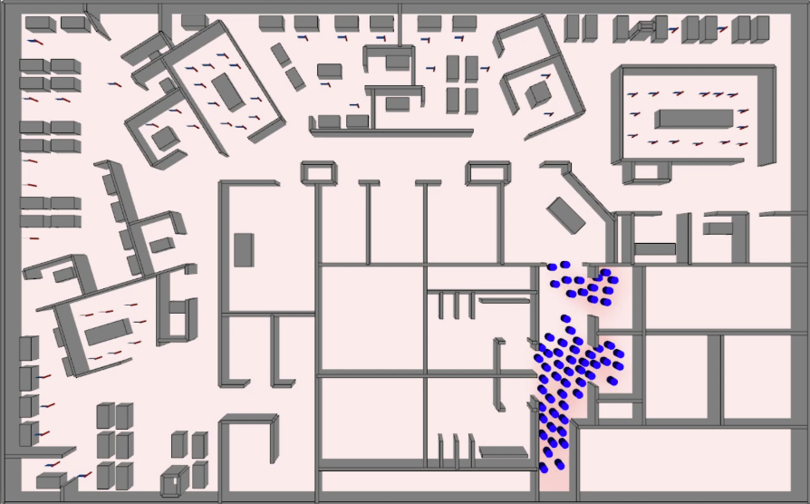
Movement (social forces) and Temperature
Image produced by the Intelligent Visual Interfaces Lab at Rutgers University, using SyDEVS and SteerSuite
Notes:
These simulation results were produced using the human-building interaction model shown previously. Simulated occupants enter a building, avoiding obstacles and one another through the use of the SteerSuite social forces model. The simulation also includes temperature, which increases due to the body heat of the occupants.

Slide 189
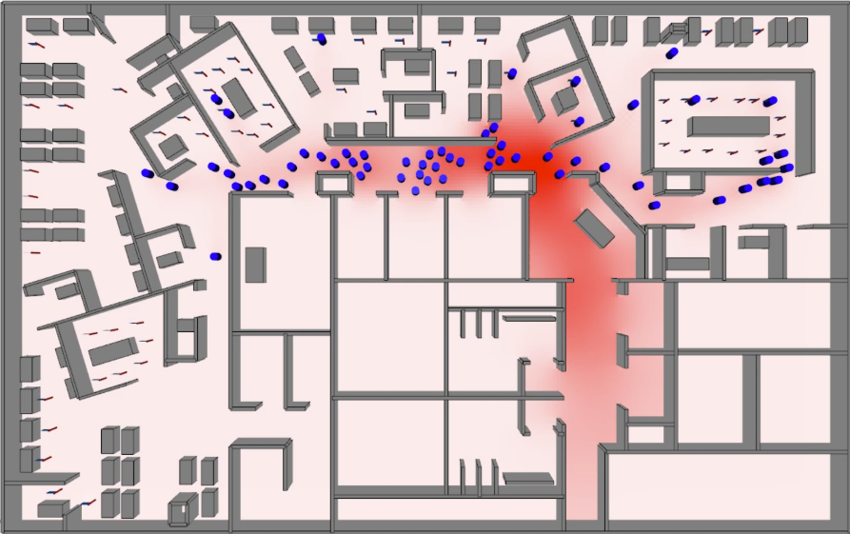
Movement (social forces) and Temperature
Image produced by the Intelligent Visual Interfaces Lab at Rutgers University, using SyDEVS and SteerSuite
Notes:
Here’s the same simulation a short time later.

Slide 190
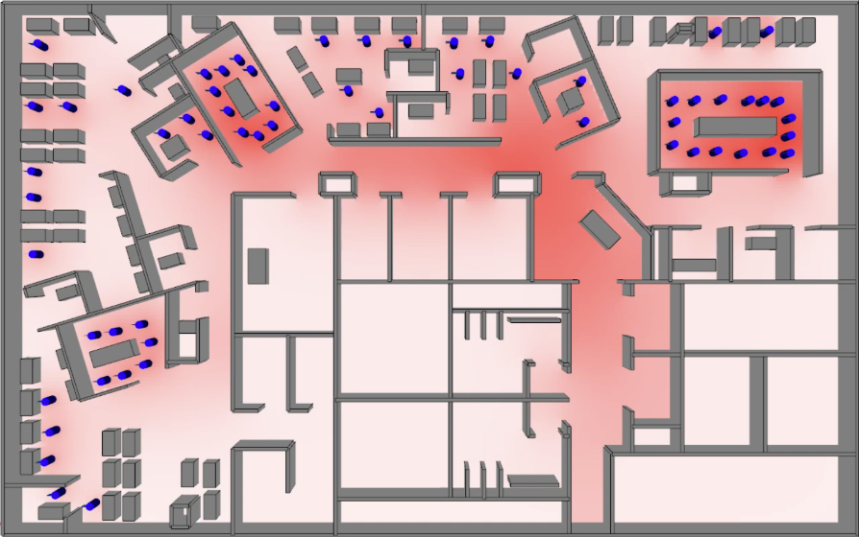
Movement (social forces) and Temperature
Image produced by the Intelligent Visual Interfaces Lab at Rutgers University, using SyDEVS and SteerSuite
Notes:
And here’s the simulation at a later time.

Slide 191
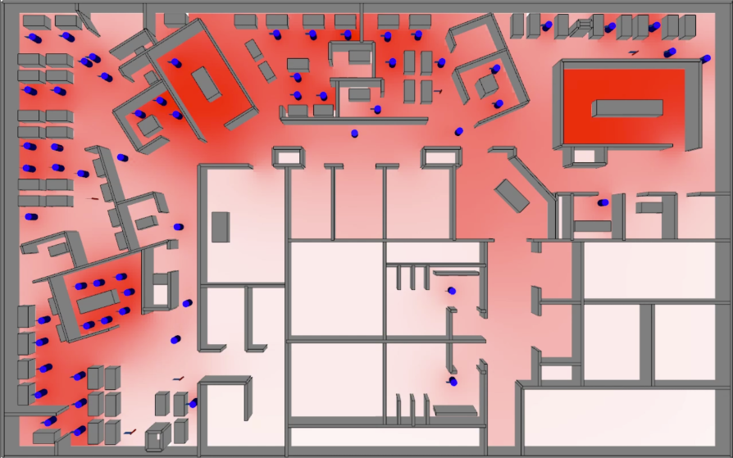
Movement (social forces) and Temperature
Image produced by the Intelligent Visual Interfaces Lab at Rutgers University, using SyDEVS and SteerSuite
Notes:
Finally, here’s an even later snapshot. Because the model does not (yet) incorporate ventilation, certain heavily utilized spaces overheat.

Slide 192
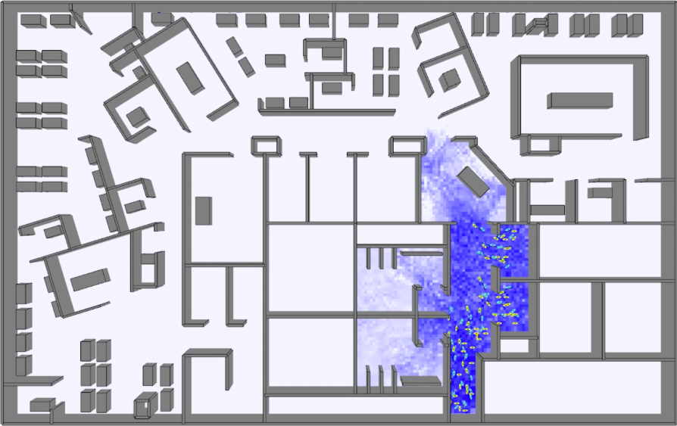
Movement (footsteps) and Noise
Image produced by the Intelligent Visual Interfaces Lab at Rutgers University, using SyDEVS and SteerSuite
Notes:
Here’s another simulation using the same framework, but the social forces algorithm is replaced with the SteerSuite footsteps model. The noise produced by the footsteps is now shown instead of temperature.

Slide 193
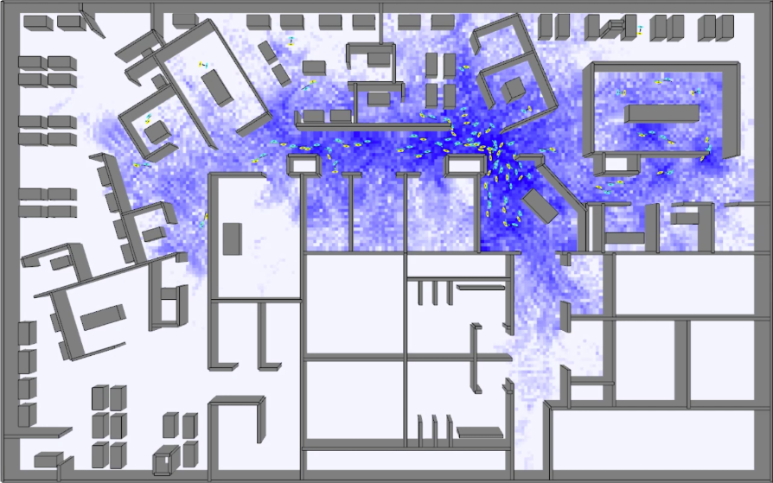
Movement (footsteps) and Noise
Image produced by the Intelligent Visual Interfaces Lab at Rutgers University, using SyDEVS and SteerSuite
Notes:
Here’s the same simulation a short time later. It becomes clear which areas in the building are likely to be most affected by noise. Simulations such as these have the potential to help designers predict the effect of various space layout options on the experiences of the people who will use the space, as well as the energy required to maintain comfortable conditions.

Slide 194
https://autodesk.github.io/sydevs/
Google "SyDEVS"
Notes:
The techniques demonstrated in this presentation can be put into practice using the SyDEVS open source C++ library.

Slide 195
Agent-Based Modeling with Symmetric DEVS
Rhys Goldstein
Autodesk Research
Email: rhys.goldstein@autodesk.com
Search for: SyDEVS
Notes:
Please contact Rhys Goldstein for more information, or search for “SyDEVS” and visit the website.

